Slide 1
CSS342 Data Structures, Algorithms, and Discrete Mathematics (I)

Slide 2
More on Recursion

Slide 3
Recap: Problem Solving with Recursion
Split problem into sub-problem of the same kind
Smaller size, and/or
Different data
Stopping condition
Stop the recursion when problem can be solved without further recursion
Recursion vs Stack

Slide 4
Recursive Problem

Slide 5
”guess them all”
?
?
?
A gift in one of the box

Slide 6
Backtracking
Recursively try all possible solution till a solution is found
Back off if a “dead-end” is met
Output all solutions
Not all paths will lead to a answer
?
?
?

Slide 7
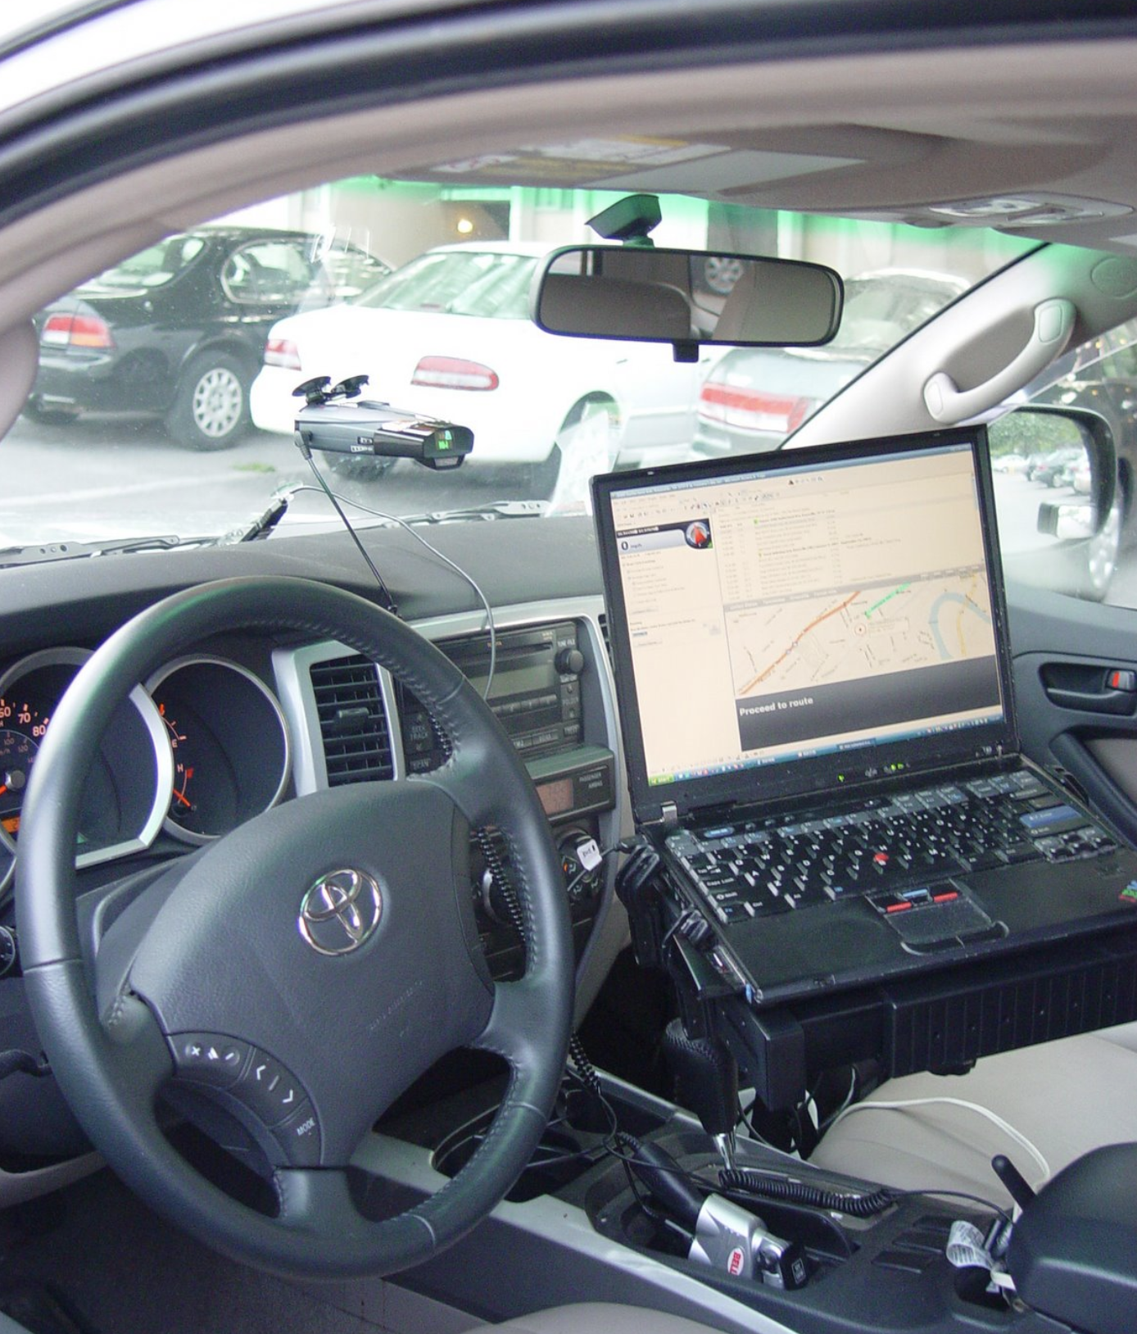
Backtracking
Kayaking trip
Fontana Lake, 07/03/2007

Slide 8
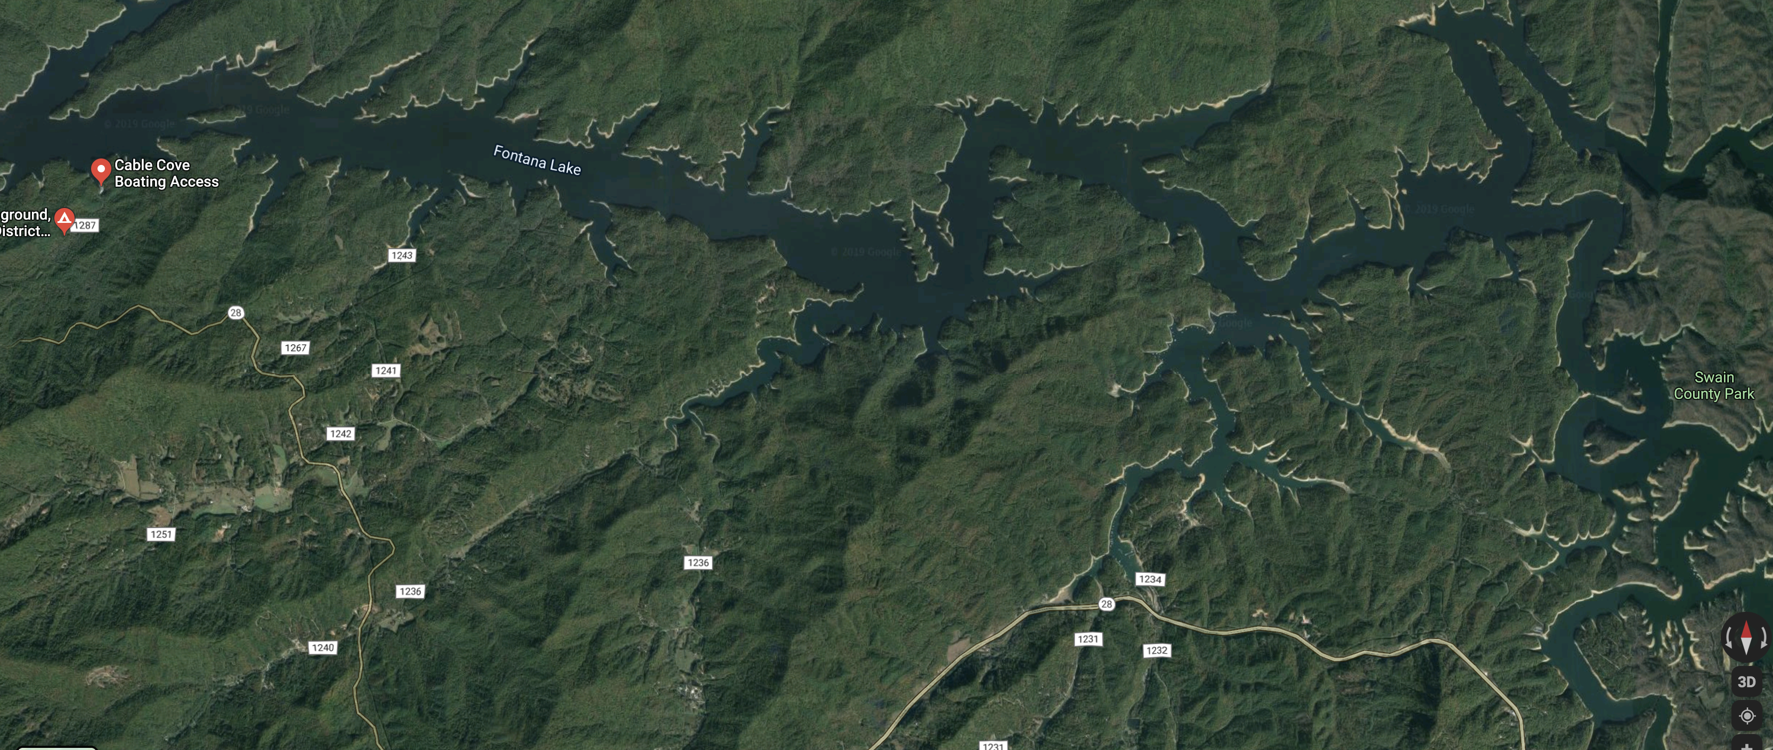
Backtracking

Slide 9
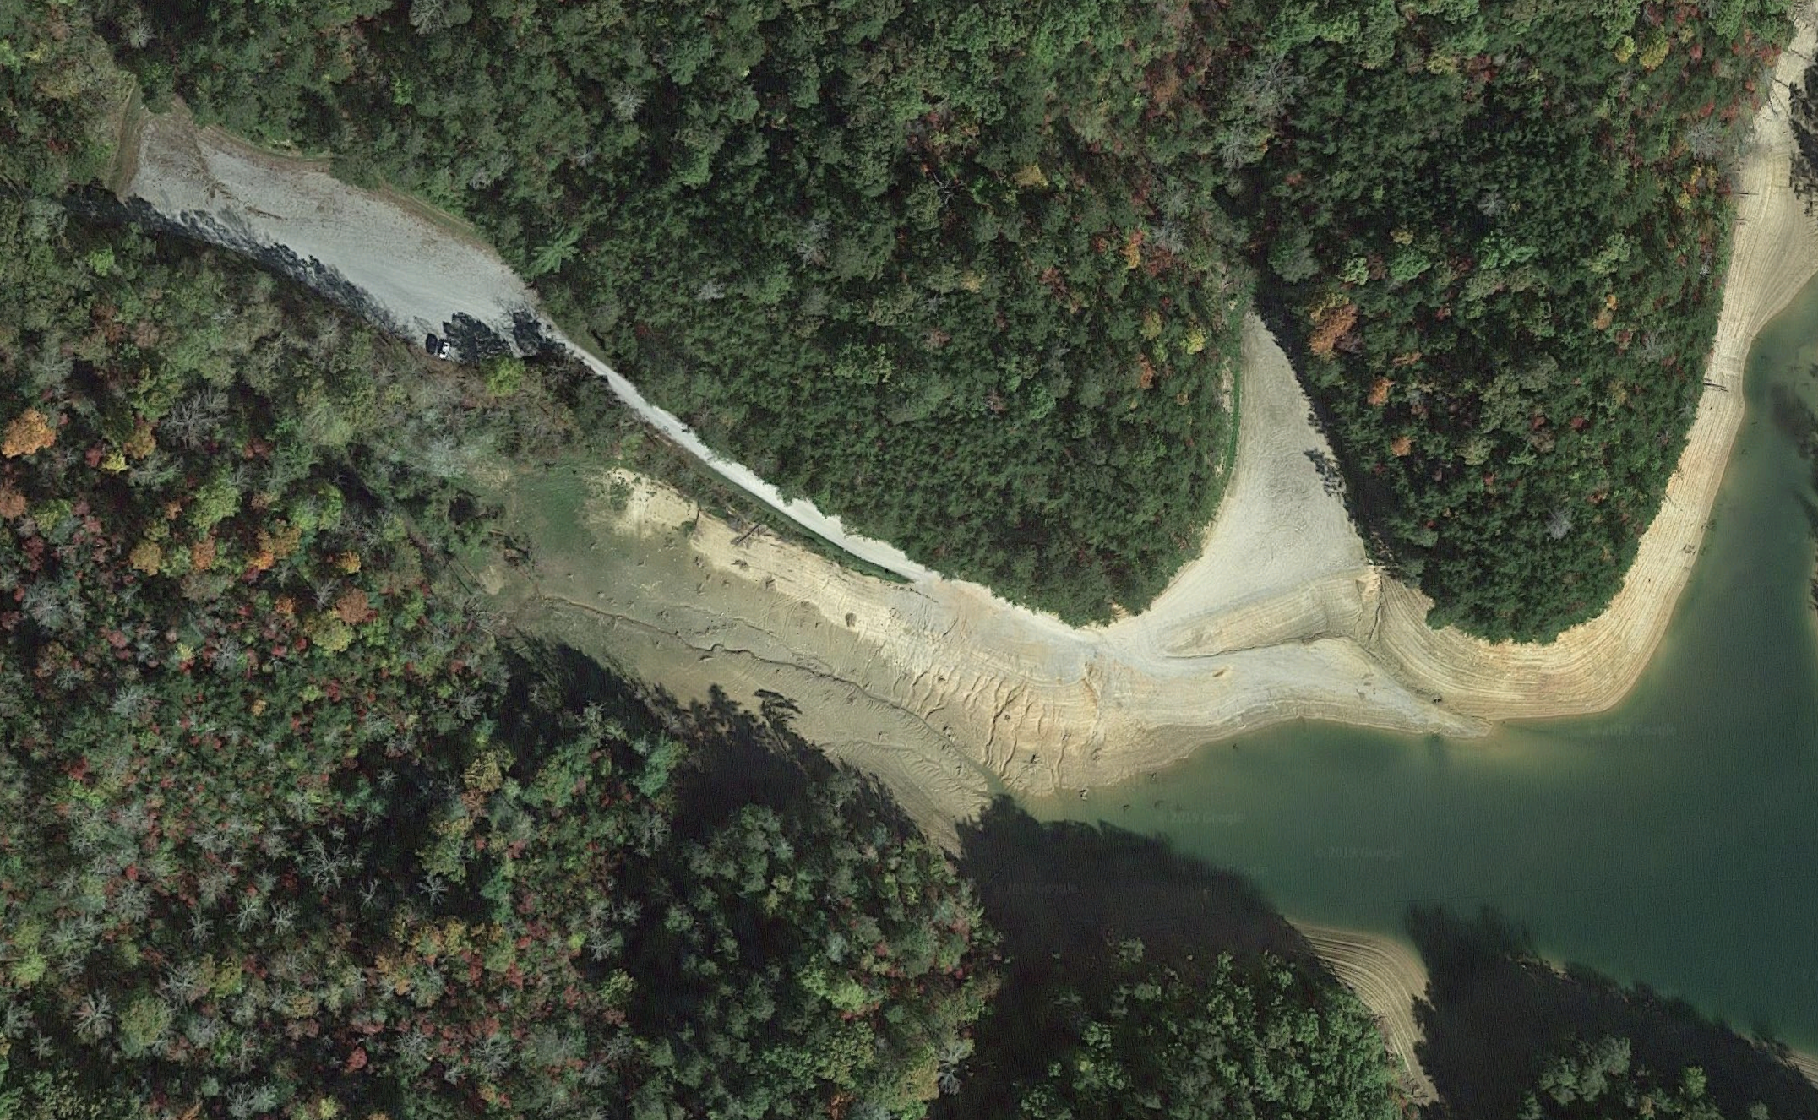
Backtracking

Slide 10

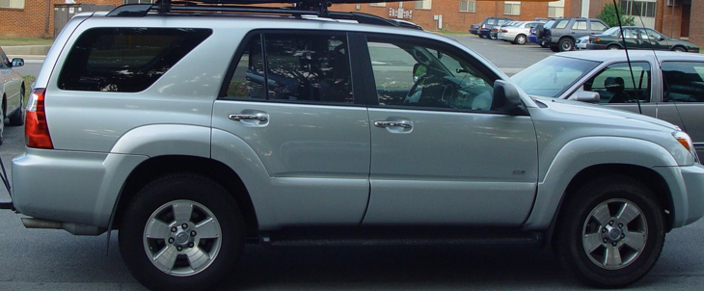
Backtracking

Slide 11
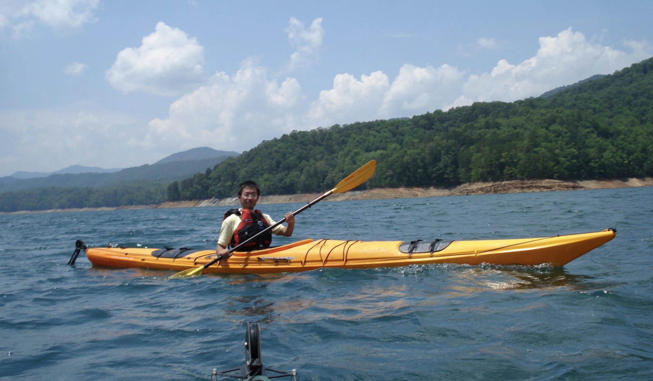
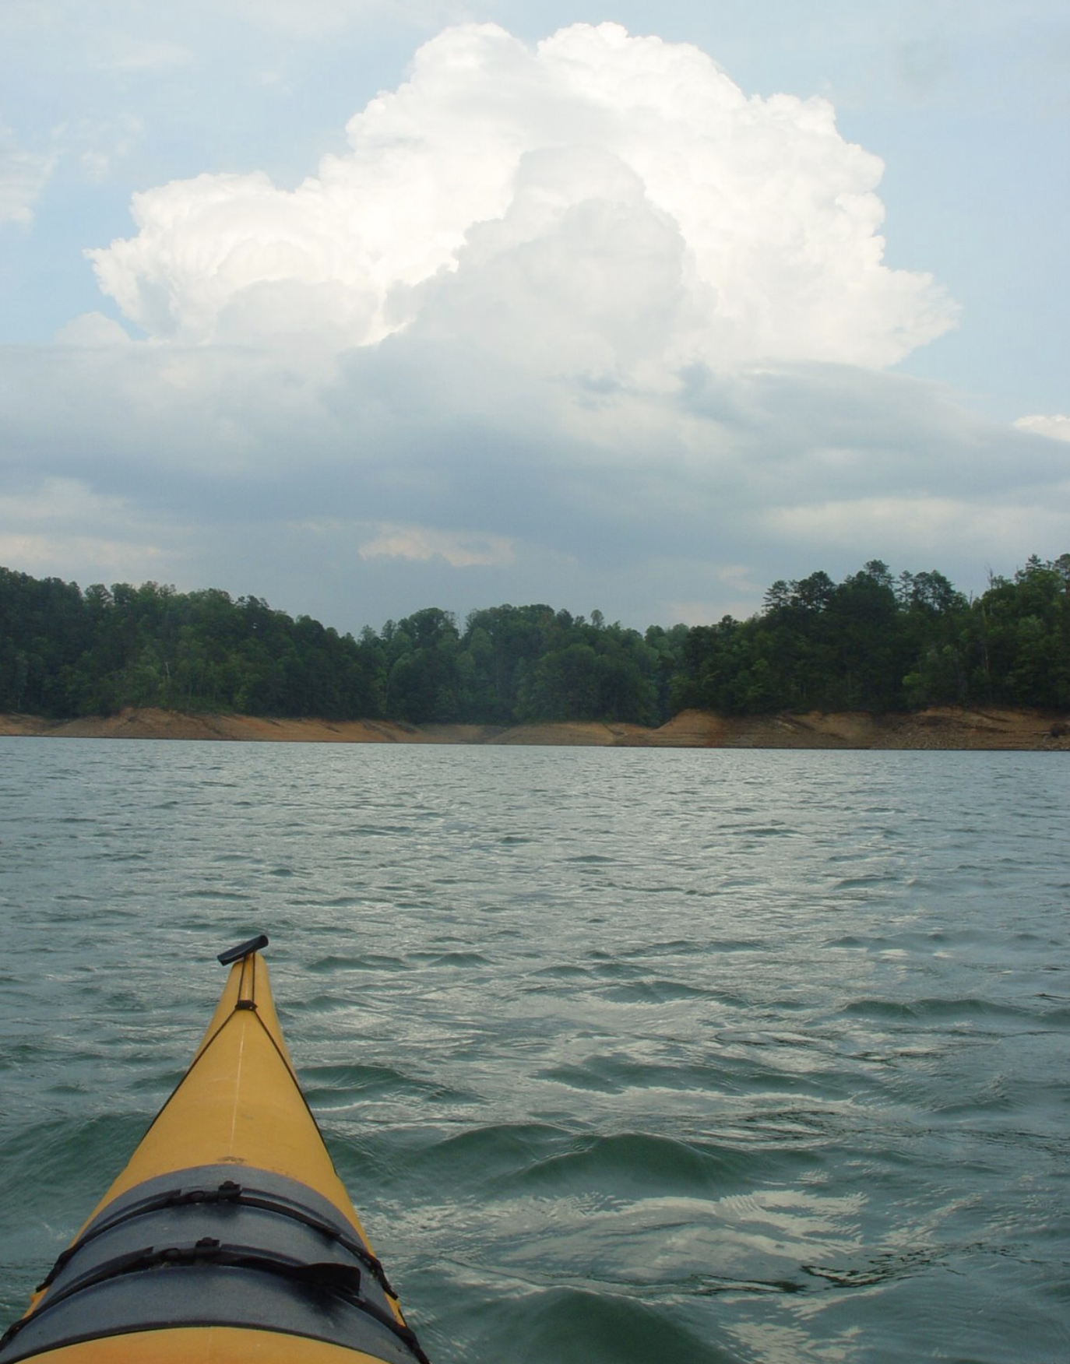
Backtracking

Slide 12
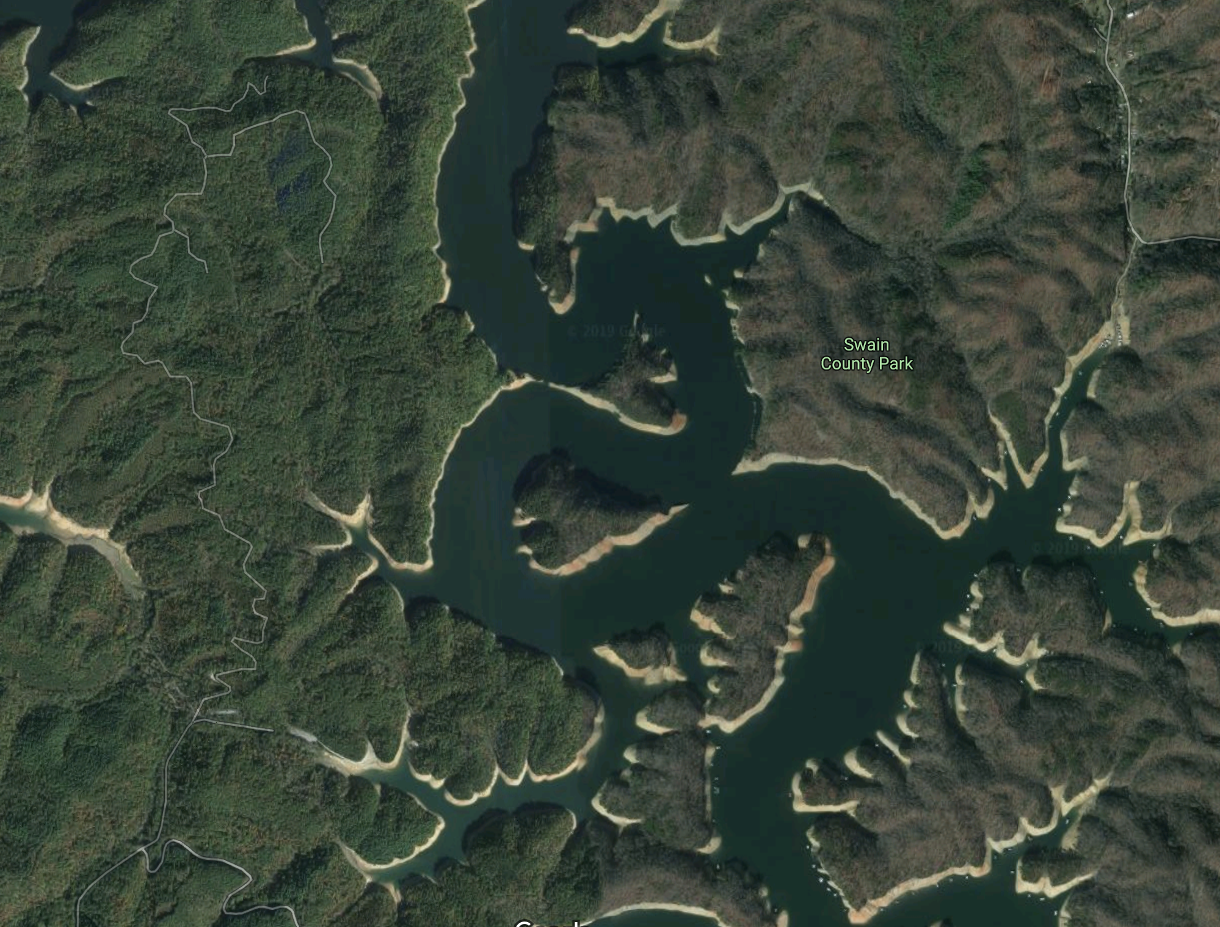
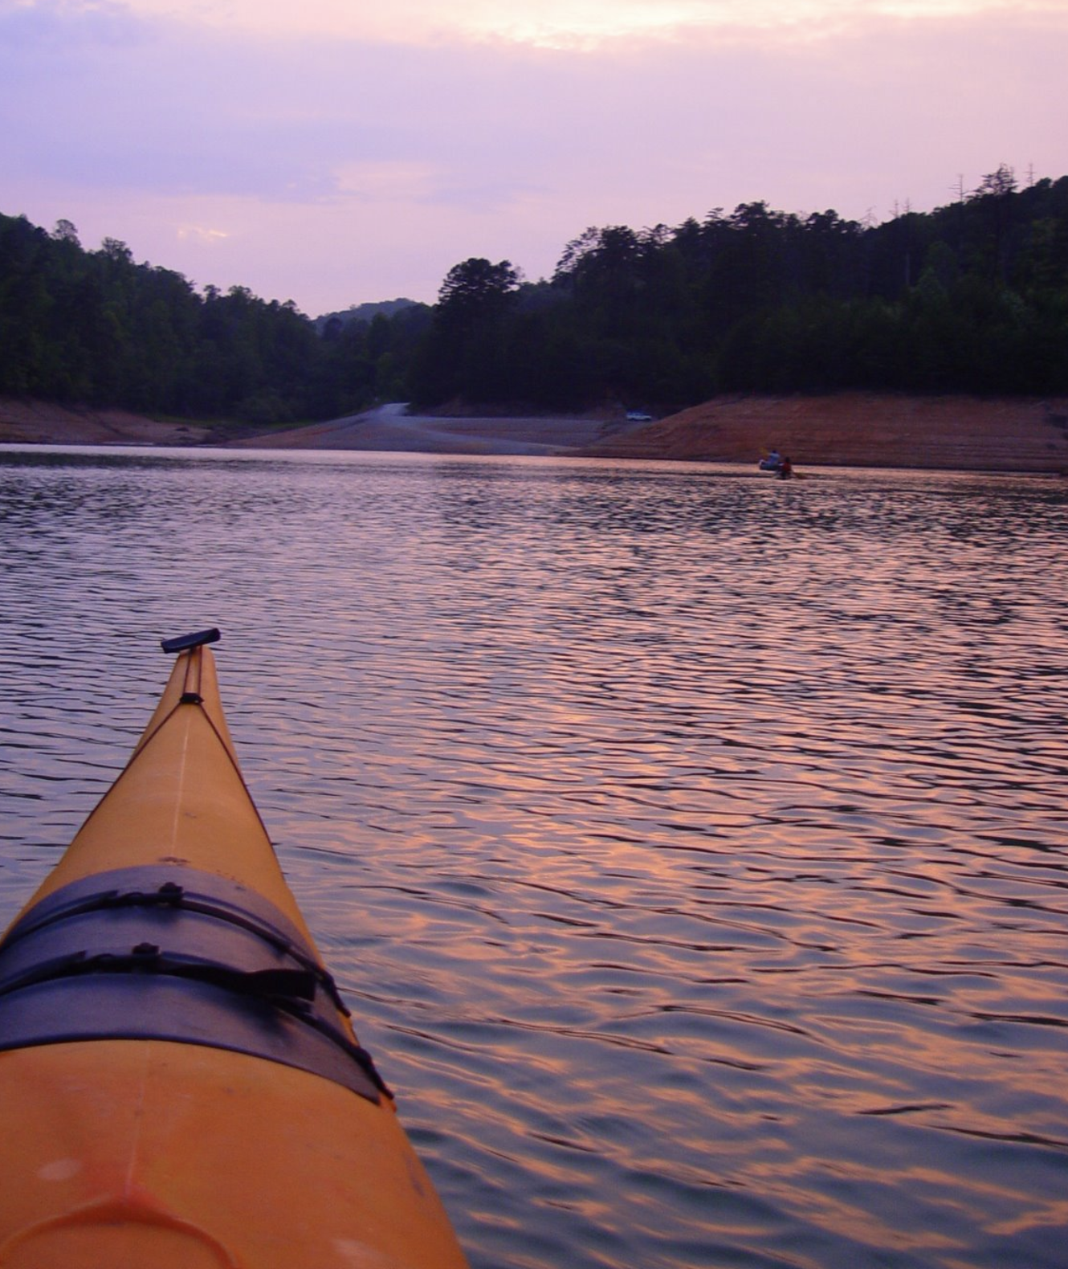
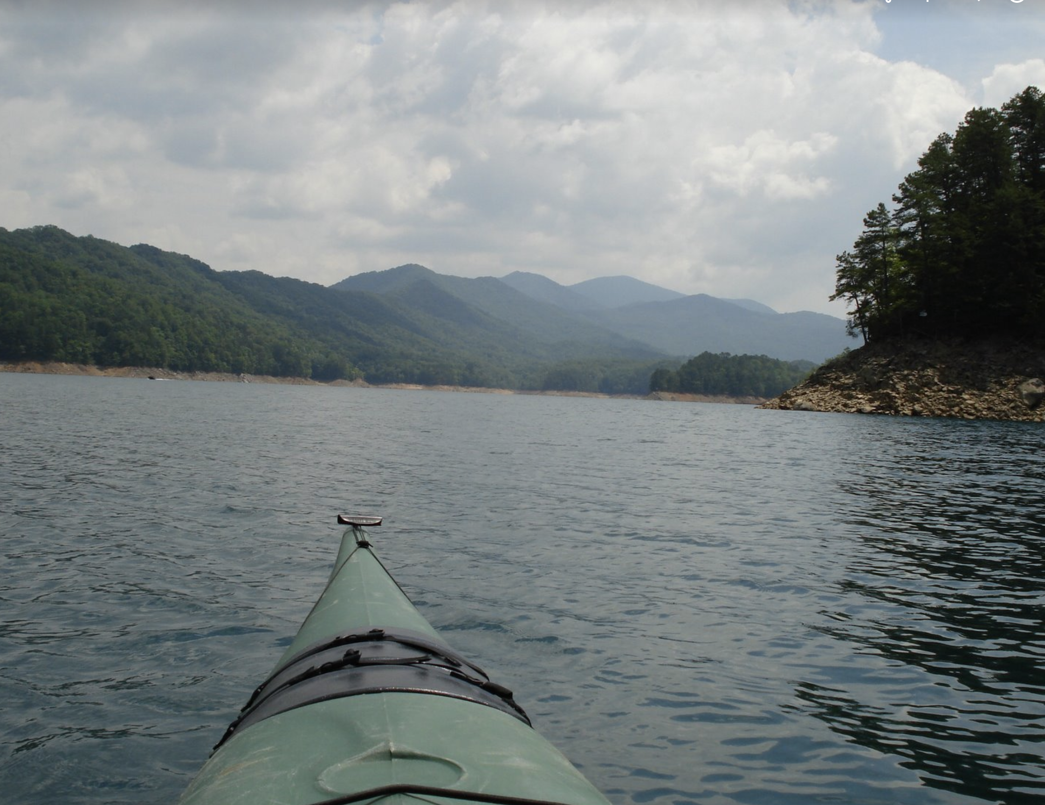
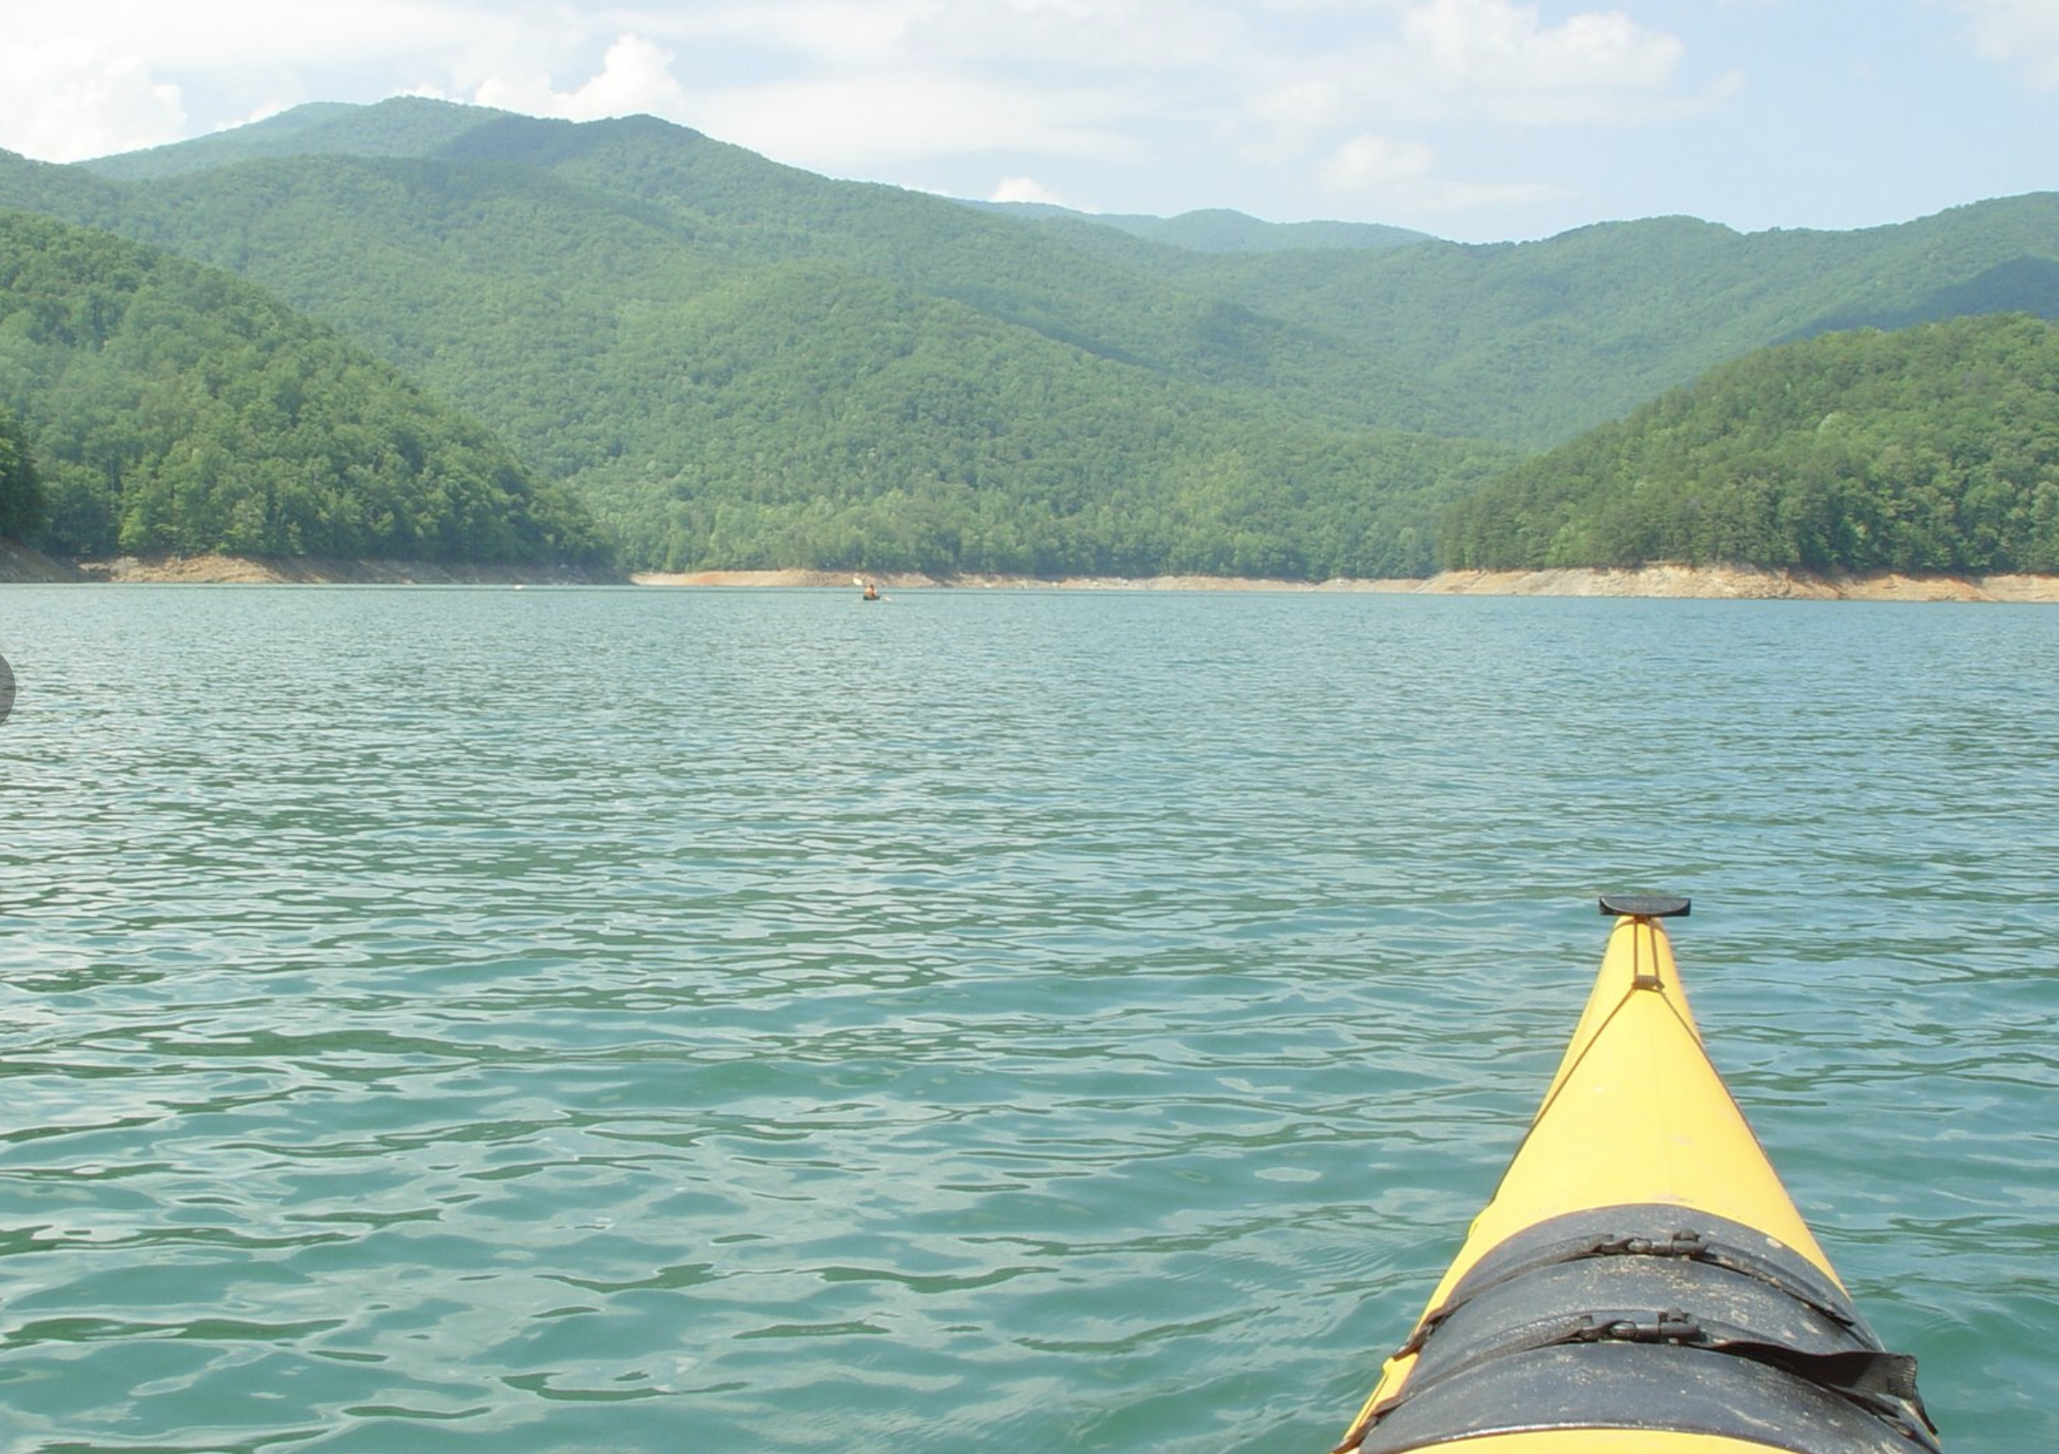
Backtracking

Slide 13
Backtracking
Move forward if there’s only one possible path
When there’s a fork, go with one of paths
If it too far, return (backtrack) to the fork, and try the other paths

Slide 14
Backtracking

Slide 15
Backtracking
TOO FAR!

Slide 16
Backtracking
NOP!

Slide 17
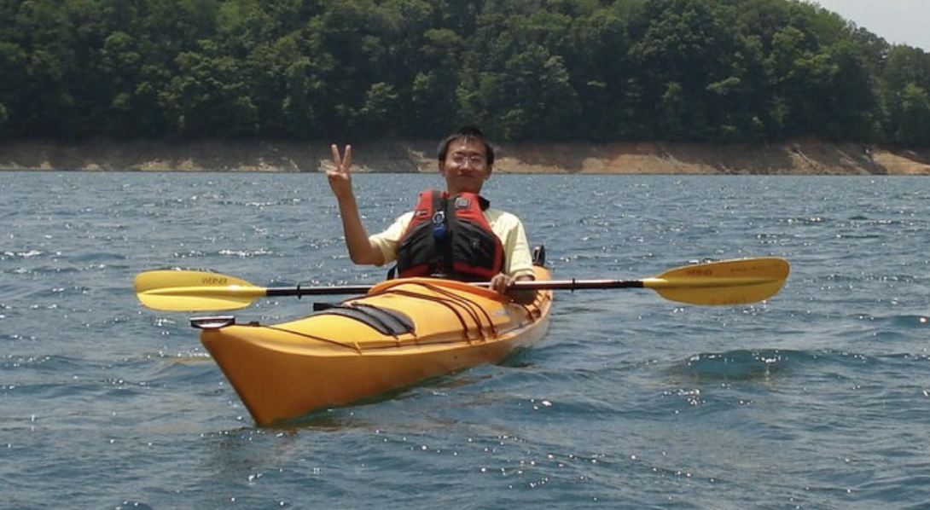
Backtracking

Slide 18
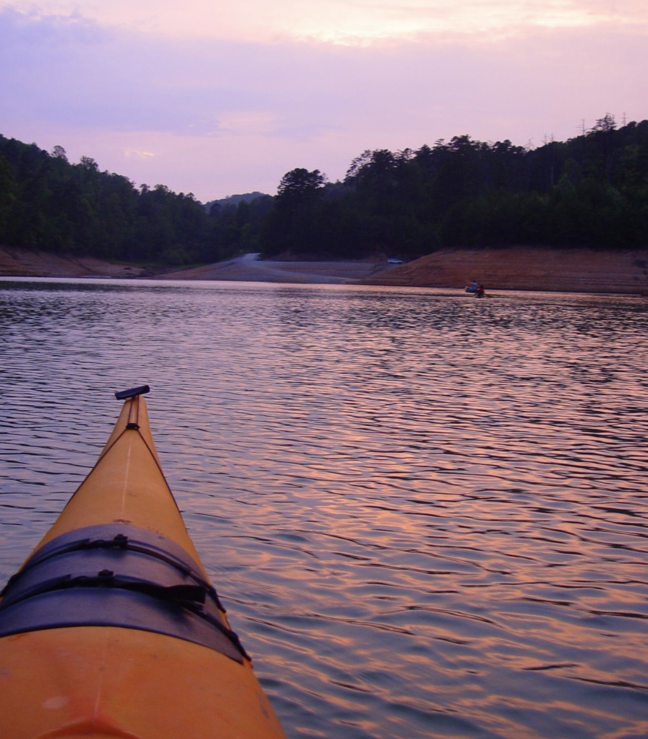
Backtracking trip
When in doubt, keep calm and backtrack!

Slide 19
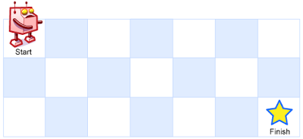


Recursion In Class Exercise: Unique Paths
A robot is located at the top-left corner of a grid
The robot can only move either down or right at any point in time.
How many possible unique paths are there?
$m$ rows
$n$ columns

Slide 20
Recursion In Class Exercise: Unique Paths
A robot is located at the top-left corner of a grid
The robot can only move either down or right at any point in time.
$m$ rows
$n$ columns

Slide 21
Recursion In Class Exercise: Unique Paths
A robot is located at the top-left corner of a grid
The robot can only move either down or right at any point in time.
$m$ rows
$n$ columns

Slide 22
Unique Paths
1
1
1
1
2
1

Slide 23
Unique Paths
1
1
1
1
1
1
2
3
4
5
1
3
6
10
15

Slide 24
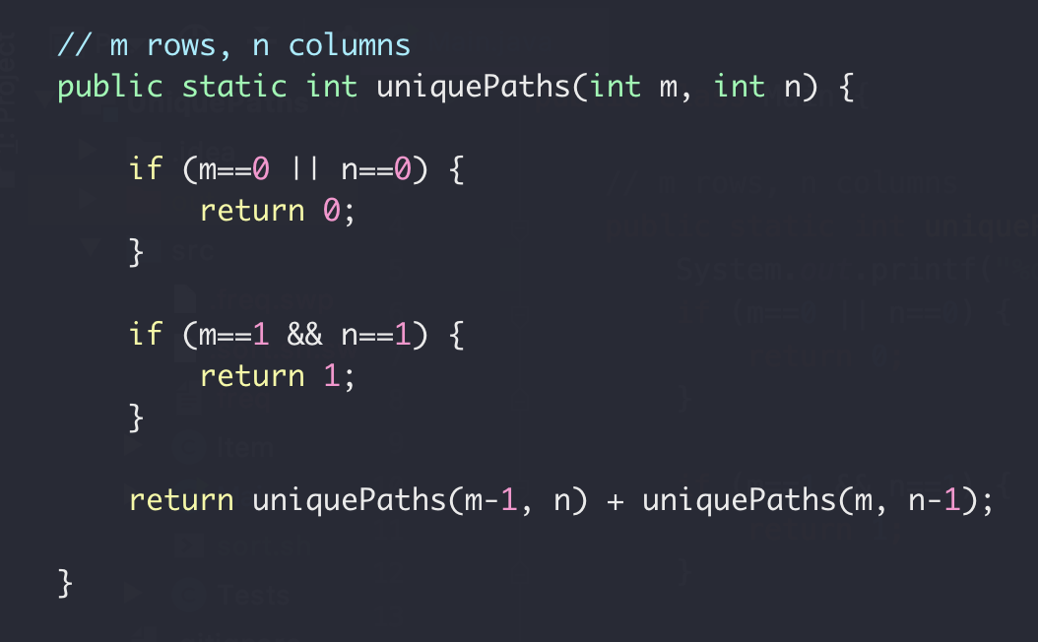
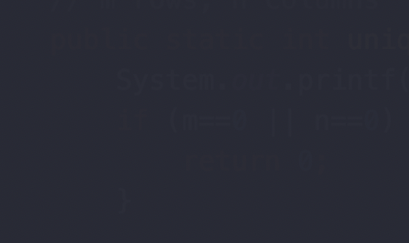

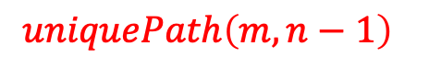
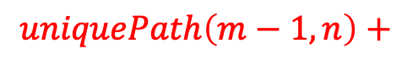


Unique Paths
1
1
1
1
1
$m$ rows
1
2
3
4
3
4
$$uniquePath\left(m, n\right)=$$
$n$ columns
$$uniquePath\left(m−1, n\right)+$$
$$uniquePath\left(m, n−1\right)$$

Slide 25
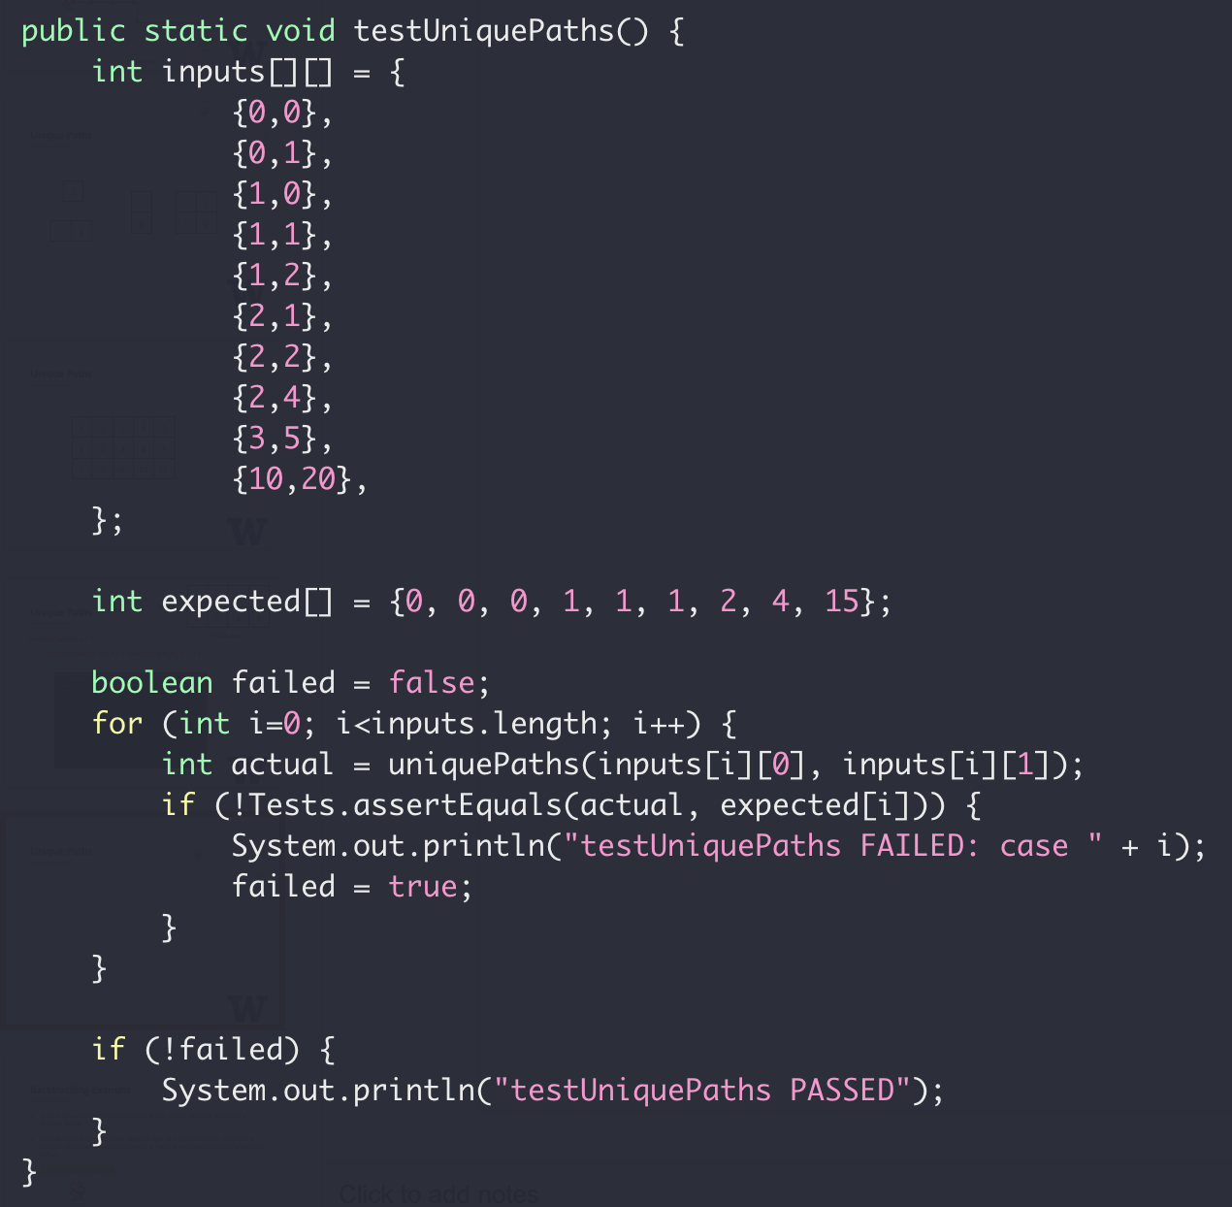
Unique Paths Tests

Slide 26
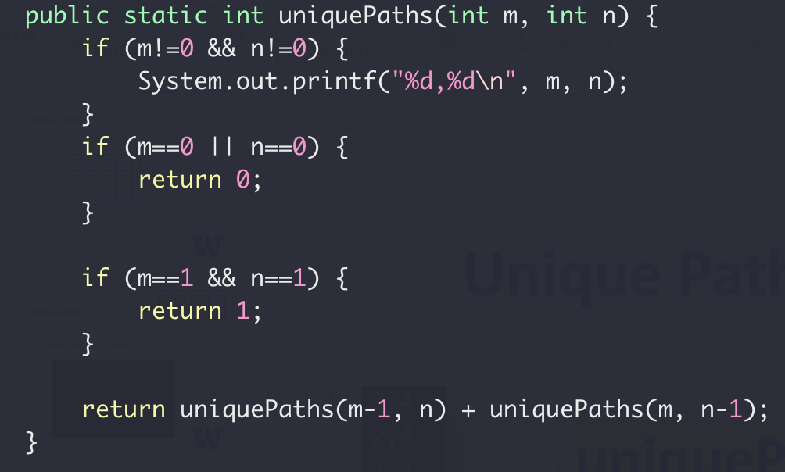

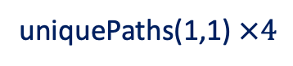
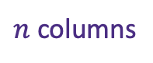
Unique Paths Tests
uniquePaths(3,4)
1
2
3
4
3,4
2,4
1,4
1,3
1,2
1,1
1
2,3
1,3
1,2
1,1
2
$m$ rows
2,2
1,2
1,1
2,1
1,1
3
$n$ columns
uniquePaths(1,1) $×4$

Slide 27
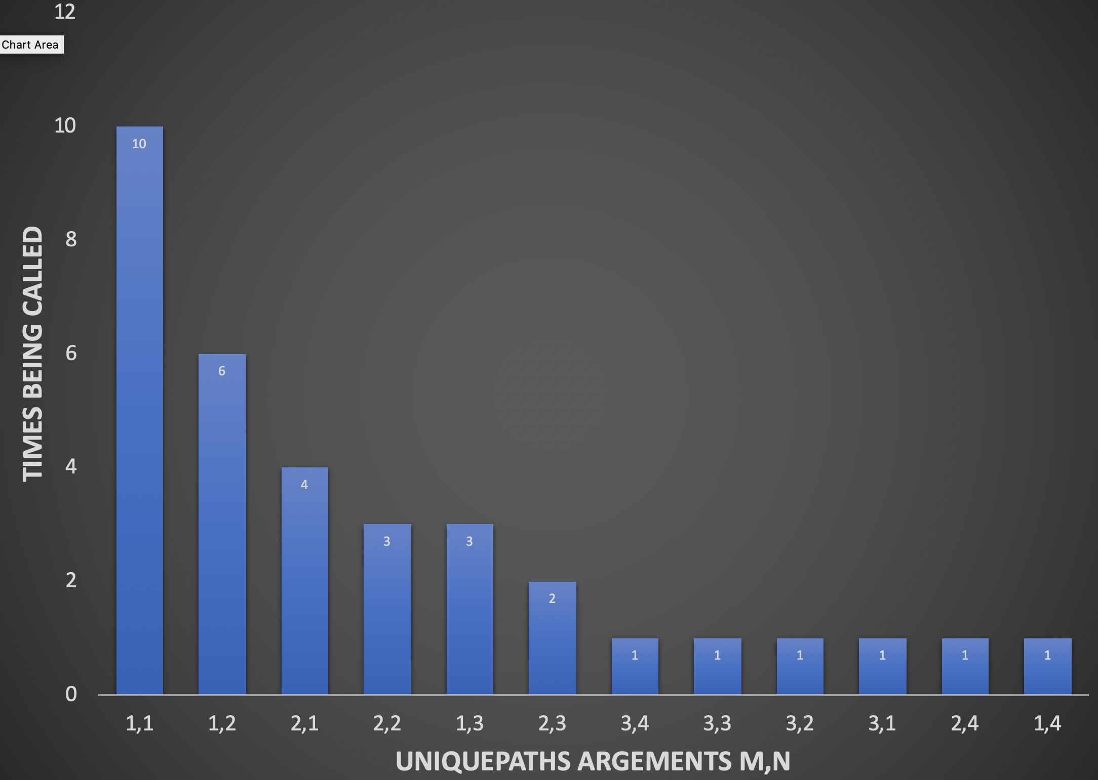

Unique Paths Tests
uniquePaths(3,4)

Slide 28
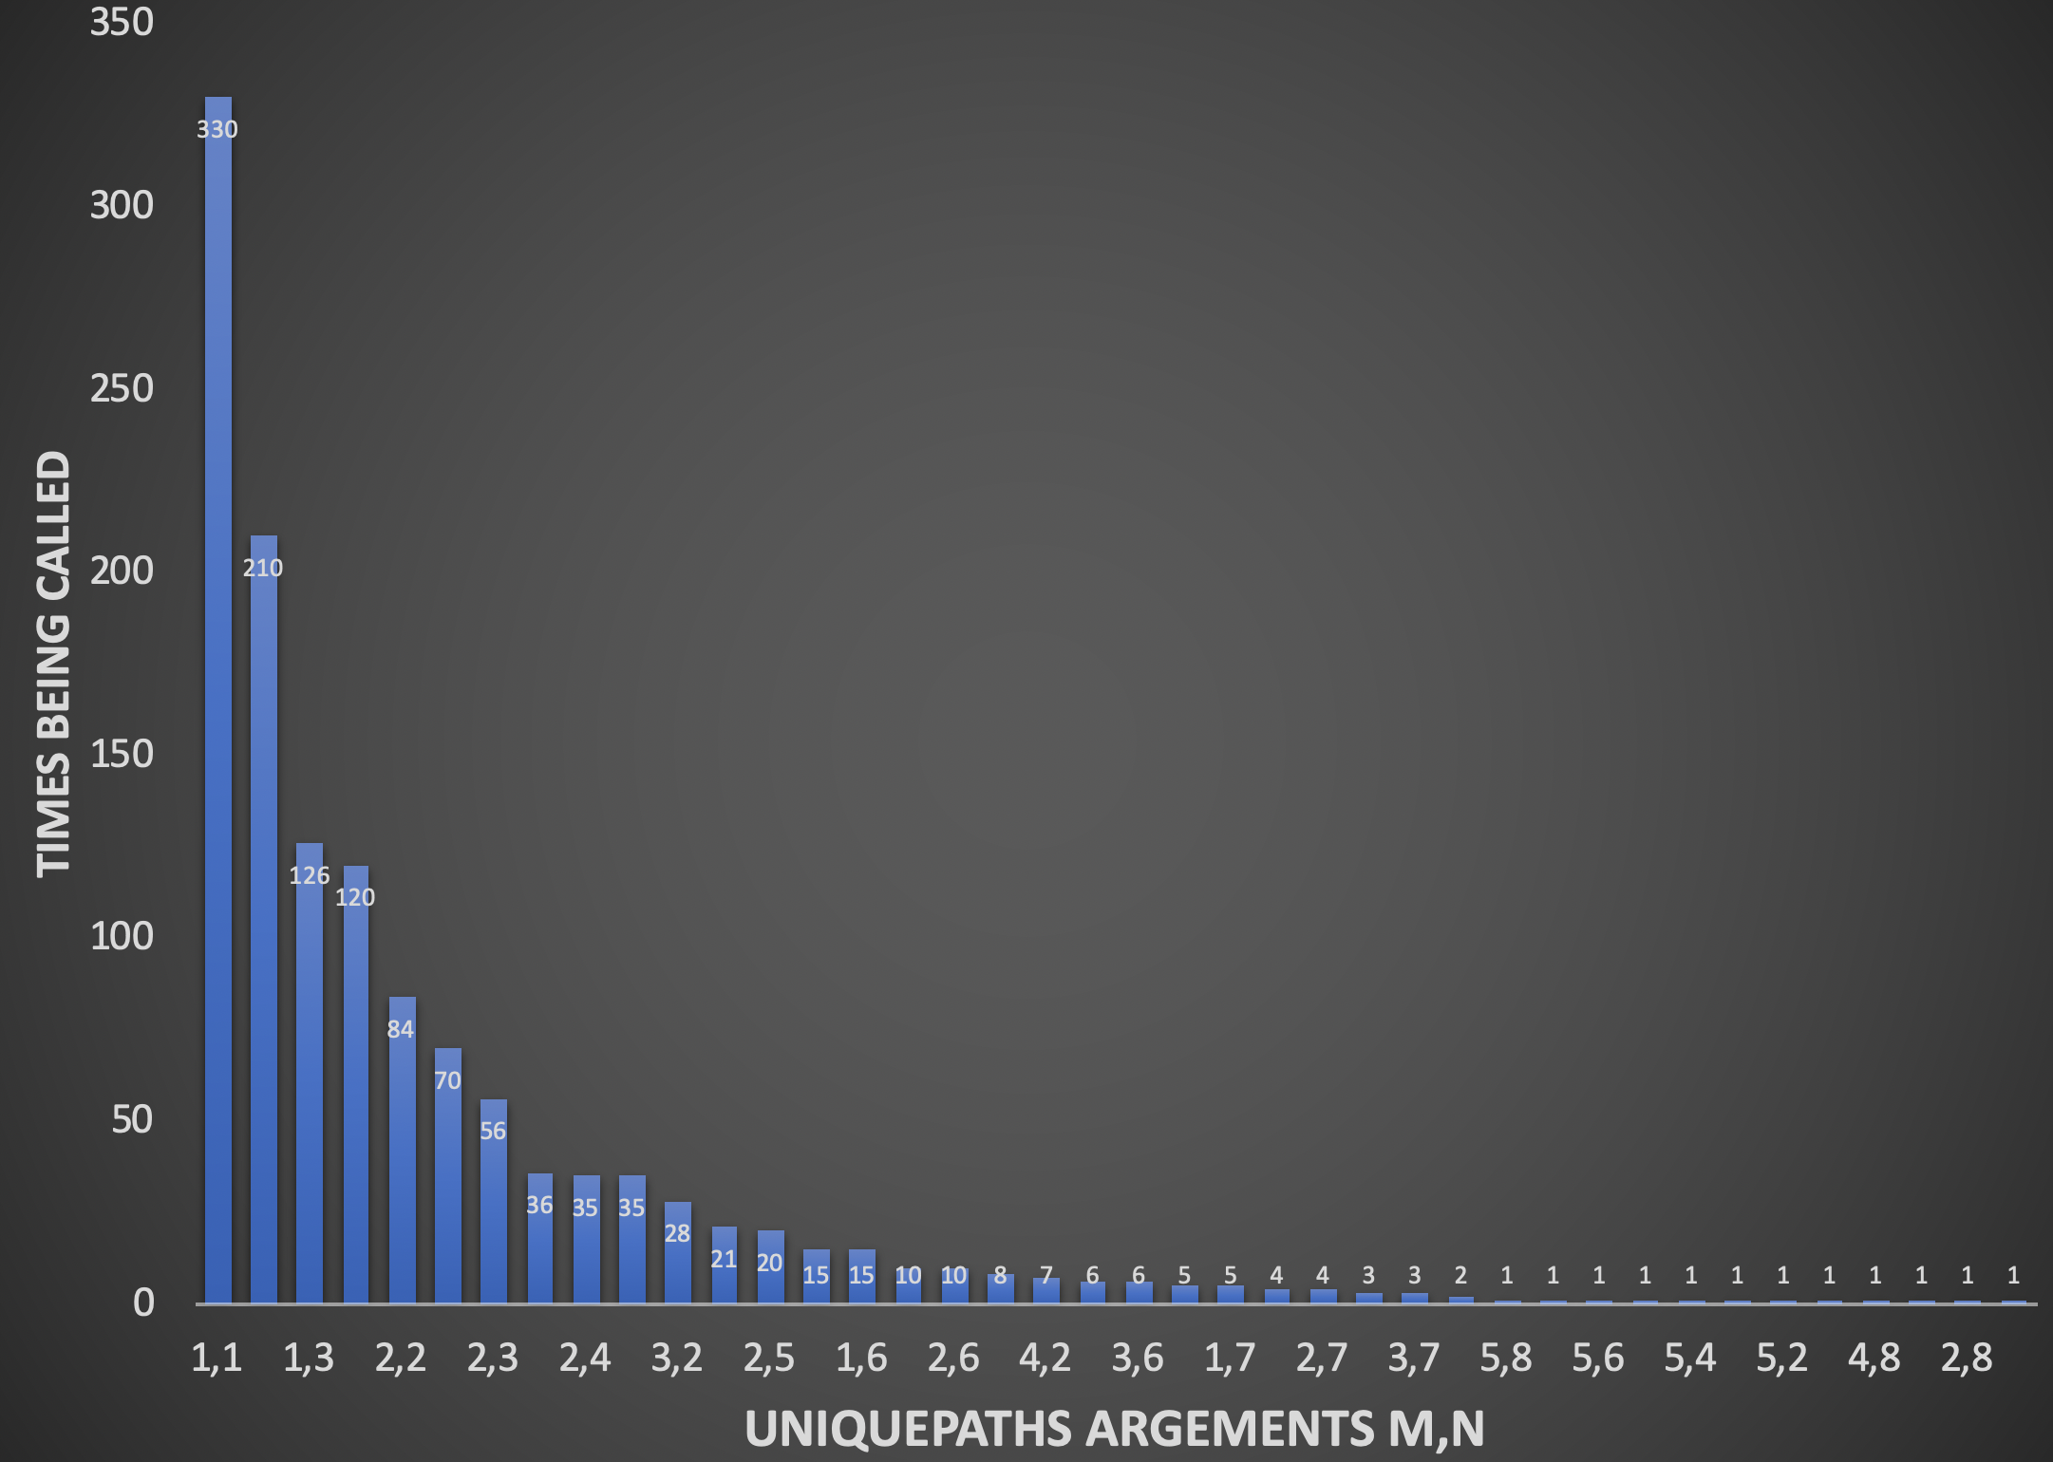
Unique Paths Tests
uniquePaths(5,8)

Slide 29
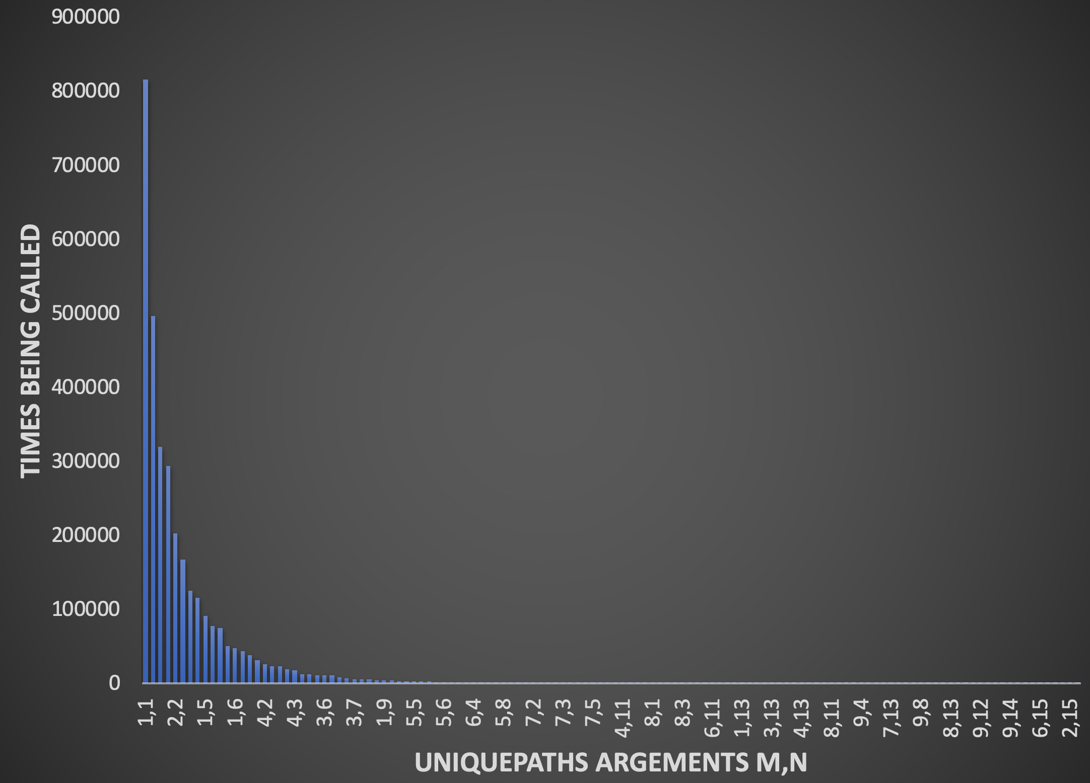
Unique Paths Tests
uniquePaths(10,15)
Repeated subproblem

Slide 30
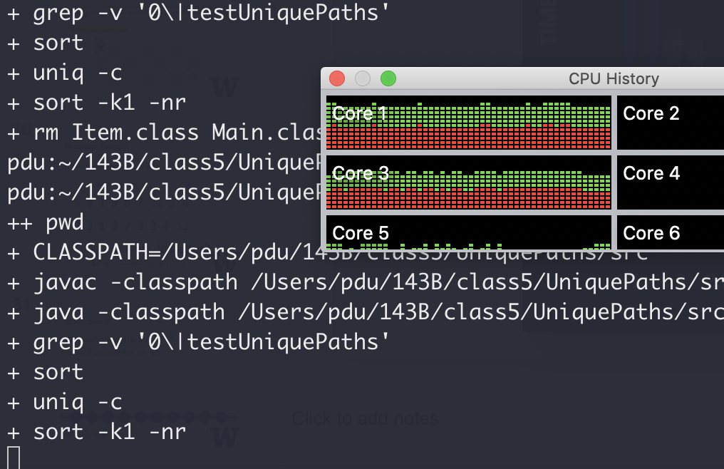

Unique Paths Tests
uniquePaths(20,30)
Dude it’s been 30 minutes…

Slide 31
Unique Paths
Repeated subproblems
1
1
1
1
1
1
2
3
4
5
recursion
1
3
6
10
15

Slide 32
Unique Paths
Repeated subproblems
1
1
1
1
1
1
2
3
4
5
1
3
6
10
15
Dynamic programming FTW

Slide 33
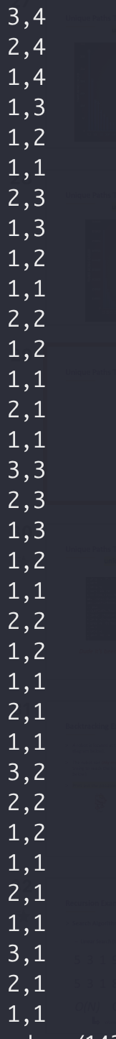
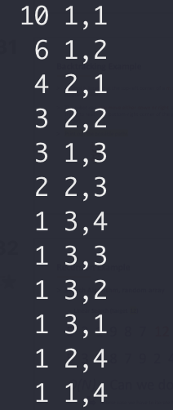
Unique Paths Tests

Slide 34
Backtracking Example
Write a function to generate all possible N pairs of balanced parentheses.
N=1 → { }
N=2 → { } { } { { } }
{ } { } { }
{ } { { } }
{ { } } { }
{ { } { } }
{ { { } } }
N=3 →

Slide 35
Backtracking Example
Write a function to generate all possible N pairs of balanced parentheses.
Balanced: number of open parenthesis >= number of close parenthesis
number of any parenthesis <= N
N=2
{ { _{(2,0)}
{ { } _{(2,1)}
{ { } } _{(2,2)}
{ _{(1,0)}
{ } _{(1,1)}
{ } { _{(2,1)}
{ } { } _{(2,2)}

Slide 36
A Search Problem (sorted array)
Target: 14
Binary search
1
3
5
7
9
10
12
12
14
14
18

Slide 37
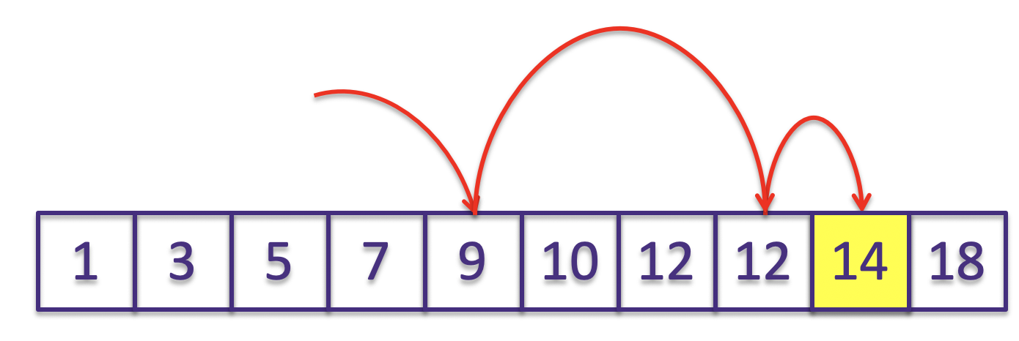
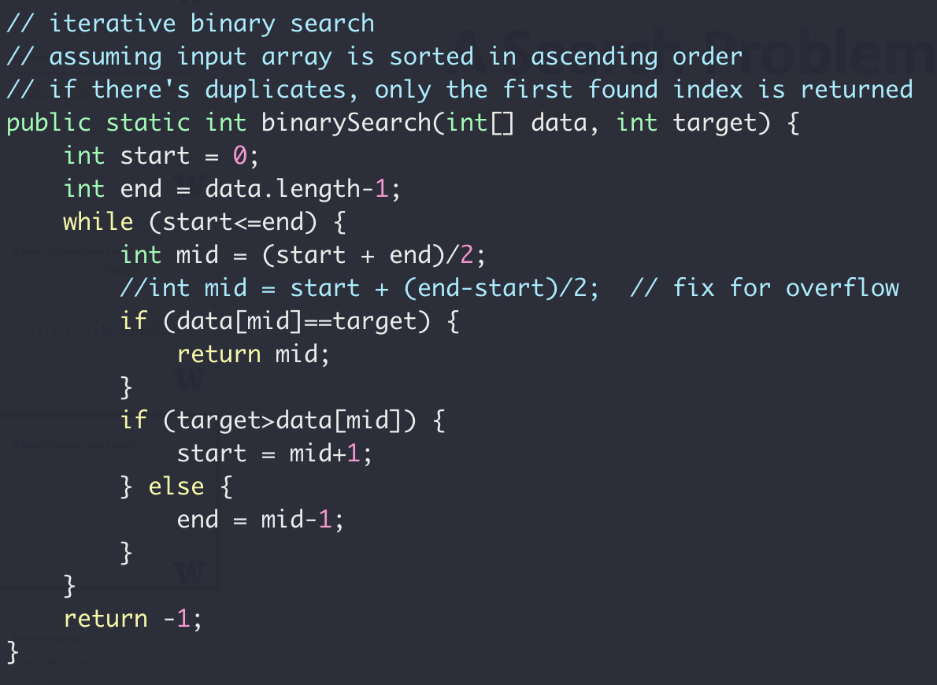
A Search Problem (sorted array)
Iteratively

Slide 38
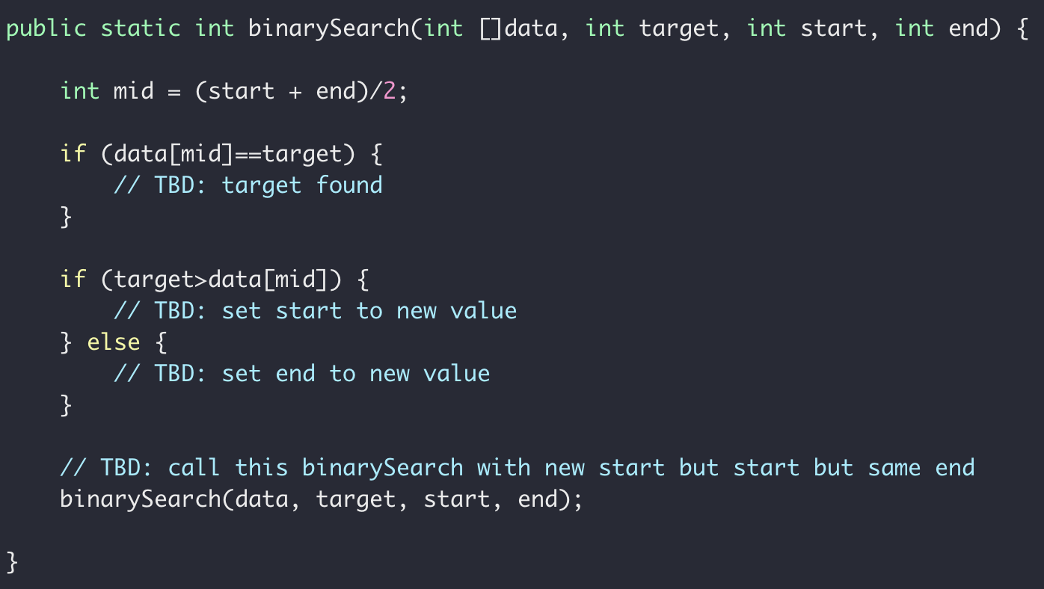
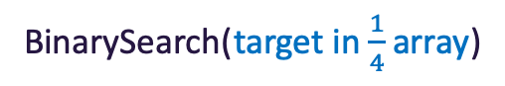

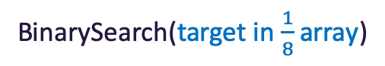
Recursive Binary Search
BinarySearch(target in whole array)
BinarySearch(target in $\frac{1}{2}$array)
BinarySearch(target in $\frac{1}{4}$array)
BinarySearch(target in $\frac{1}{8}$array)
1
3
5
7
9
10
12
12
14
18

Slide 39
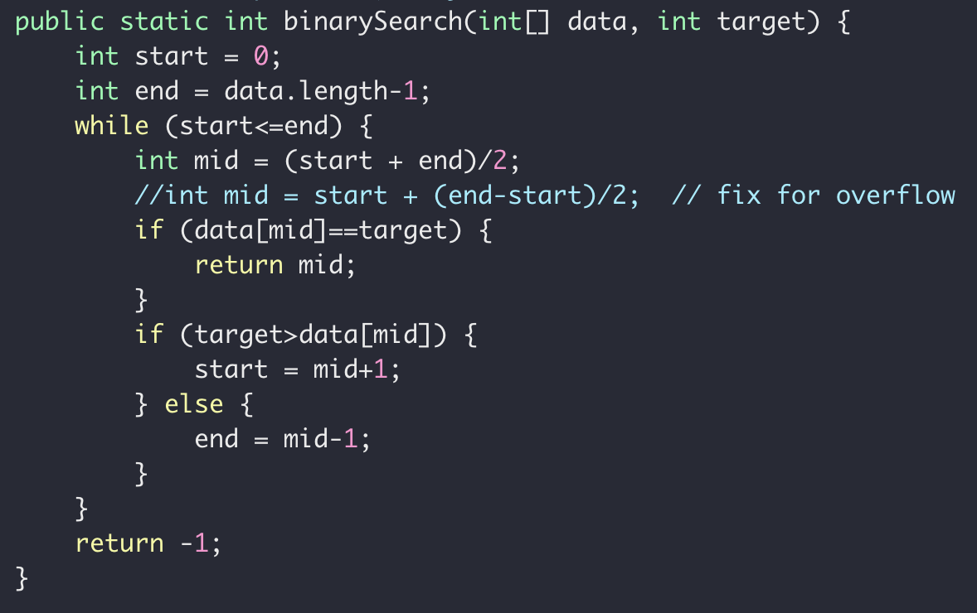
Recursive Binary Search
Iterative
Recursive

Slide 40
Binary Search Summary
Recursion
Divide and conquer
Range overflow
More efficient O(lgN) than linear search O(N)

Slide 41
Another Divide and Conquer Example
SORT
18
3
4
2
8
9
1
10
5
7

Slide 42
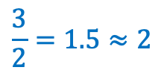
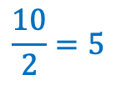
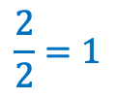
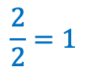
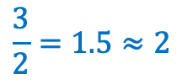
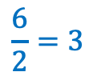
Another Divide and Conquer Example
QUICKSORT
18
3
4
2
8
9
1
10
5
7
$$\frac{10}{2}=5$$
→ Index 4
1
3
4
2
5
7
8
8
9
18
10
$$\frac{6}{2}=3$$
→ Index 2
$$\frac{3}{2}=1.5≈2$$
→ Index 1
1
3
2
4
5
7
8
10
18
8
9
$$\frac{2}{2}=1$$
$$\frac{2}{2}=1$$
$$\frac{3}{2}=1.5≈2$$

Slide 43
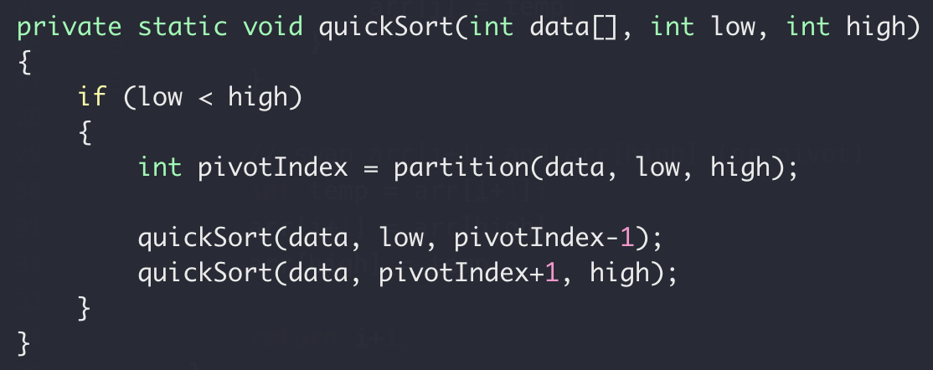

Another Divide and Conquer Example
QUICKSORT

Slide 44
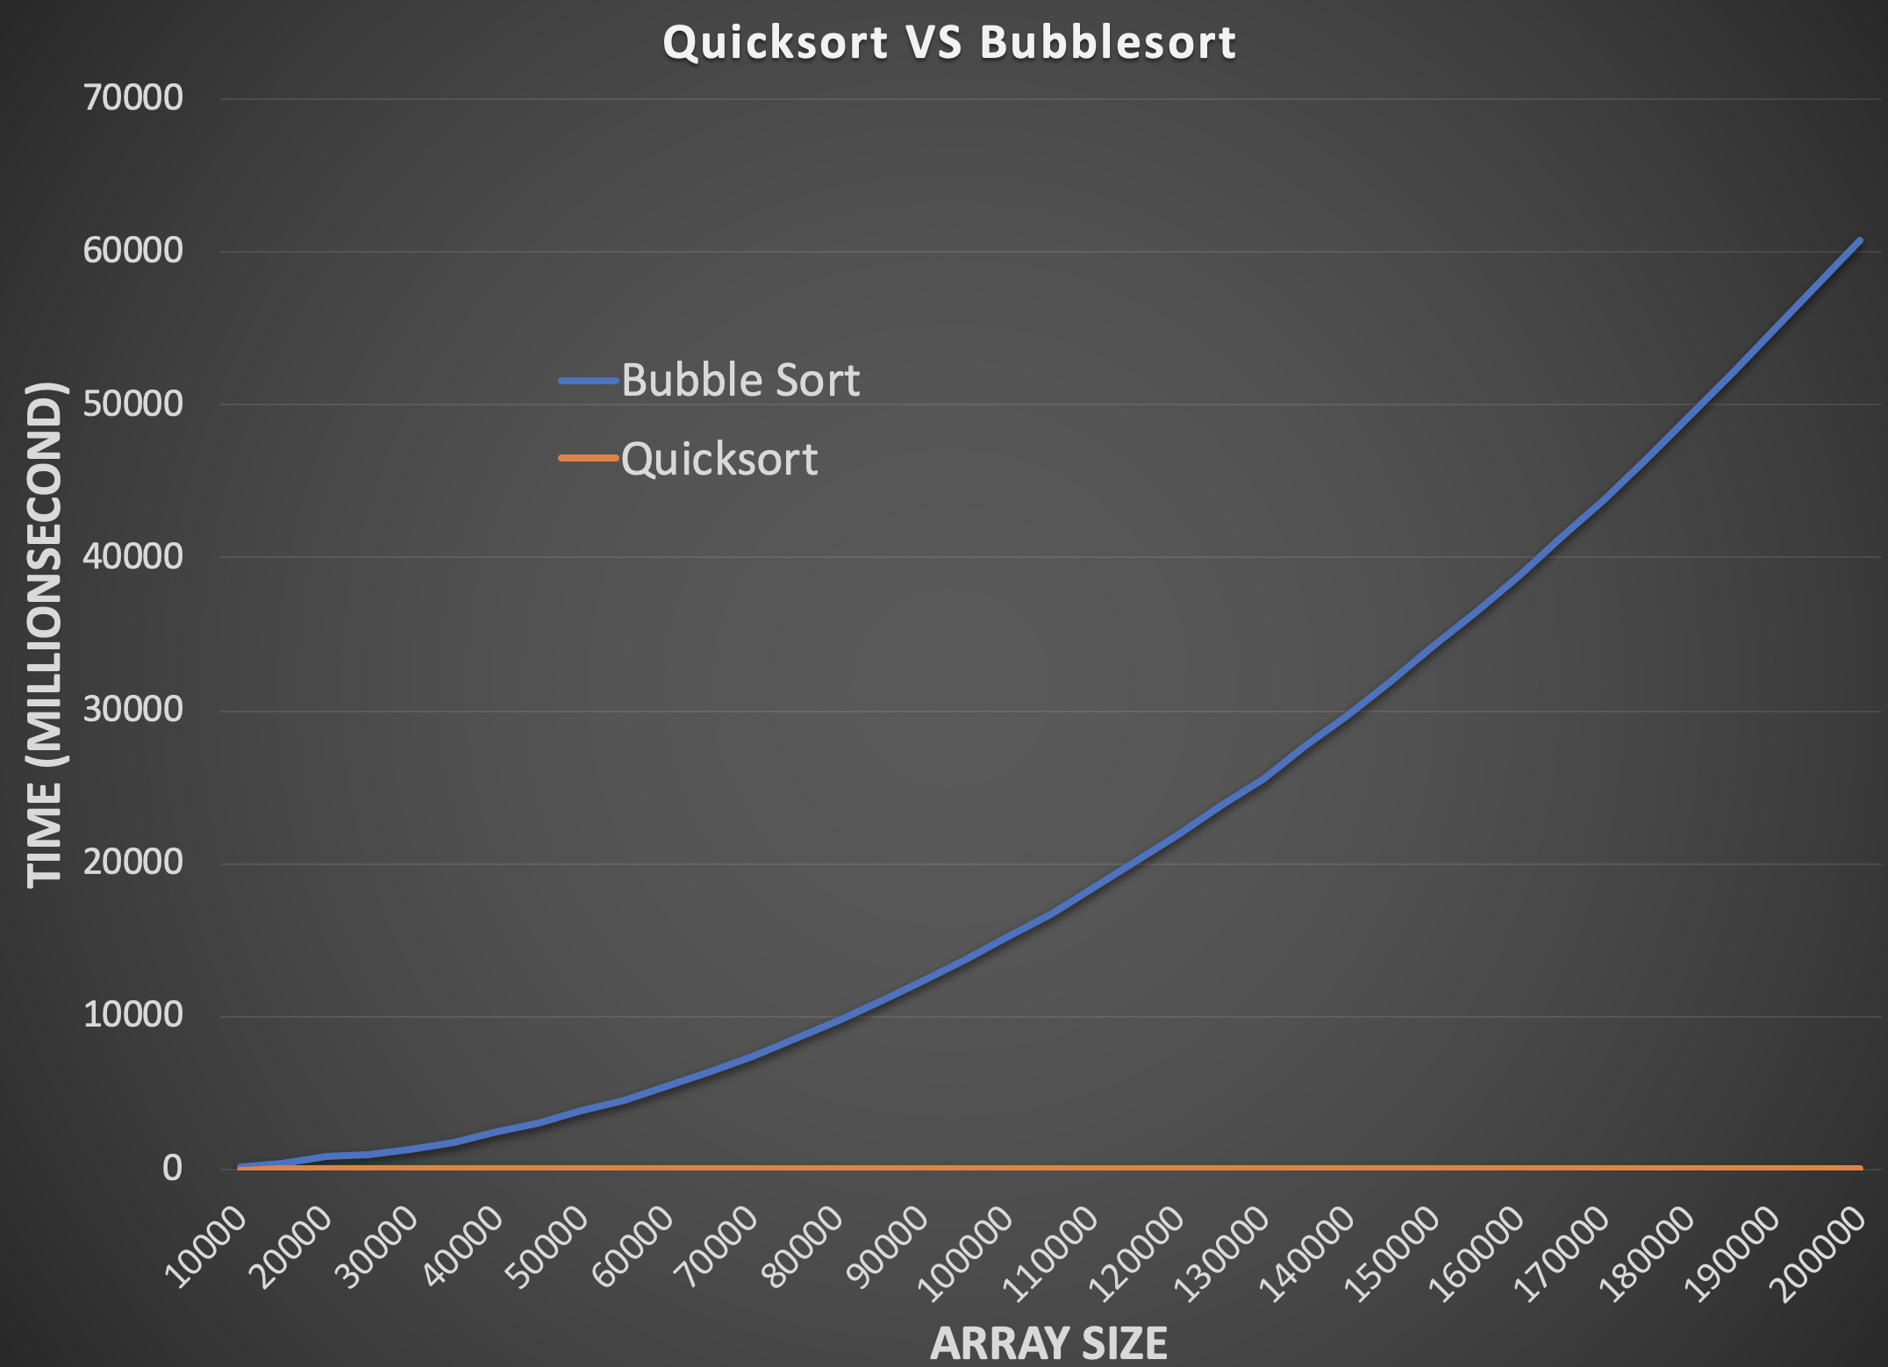
Bubble Sort vs Quick Sort

Slide 45
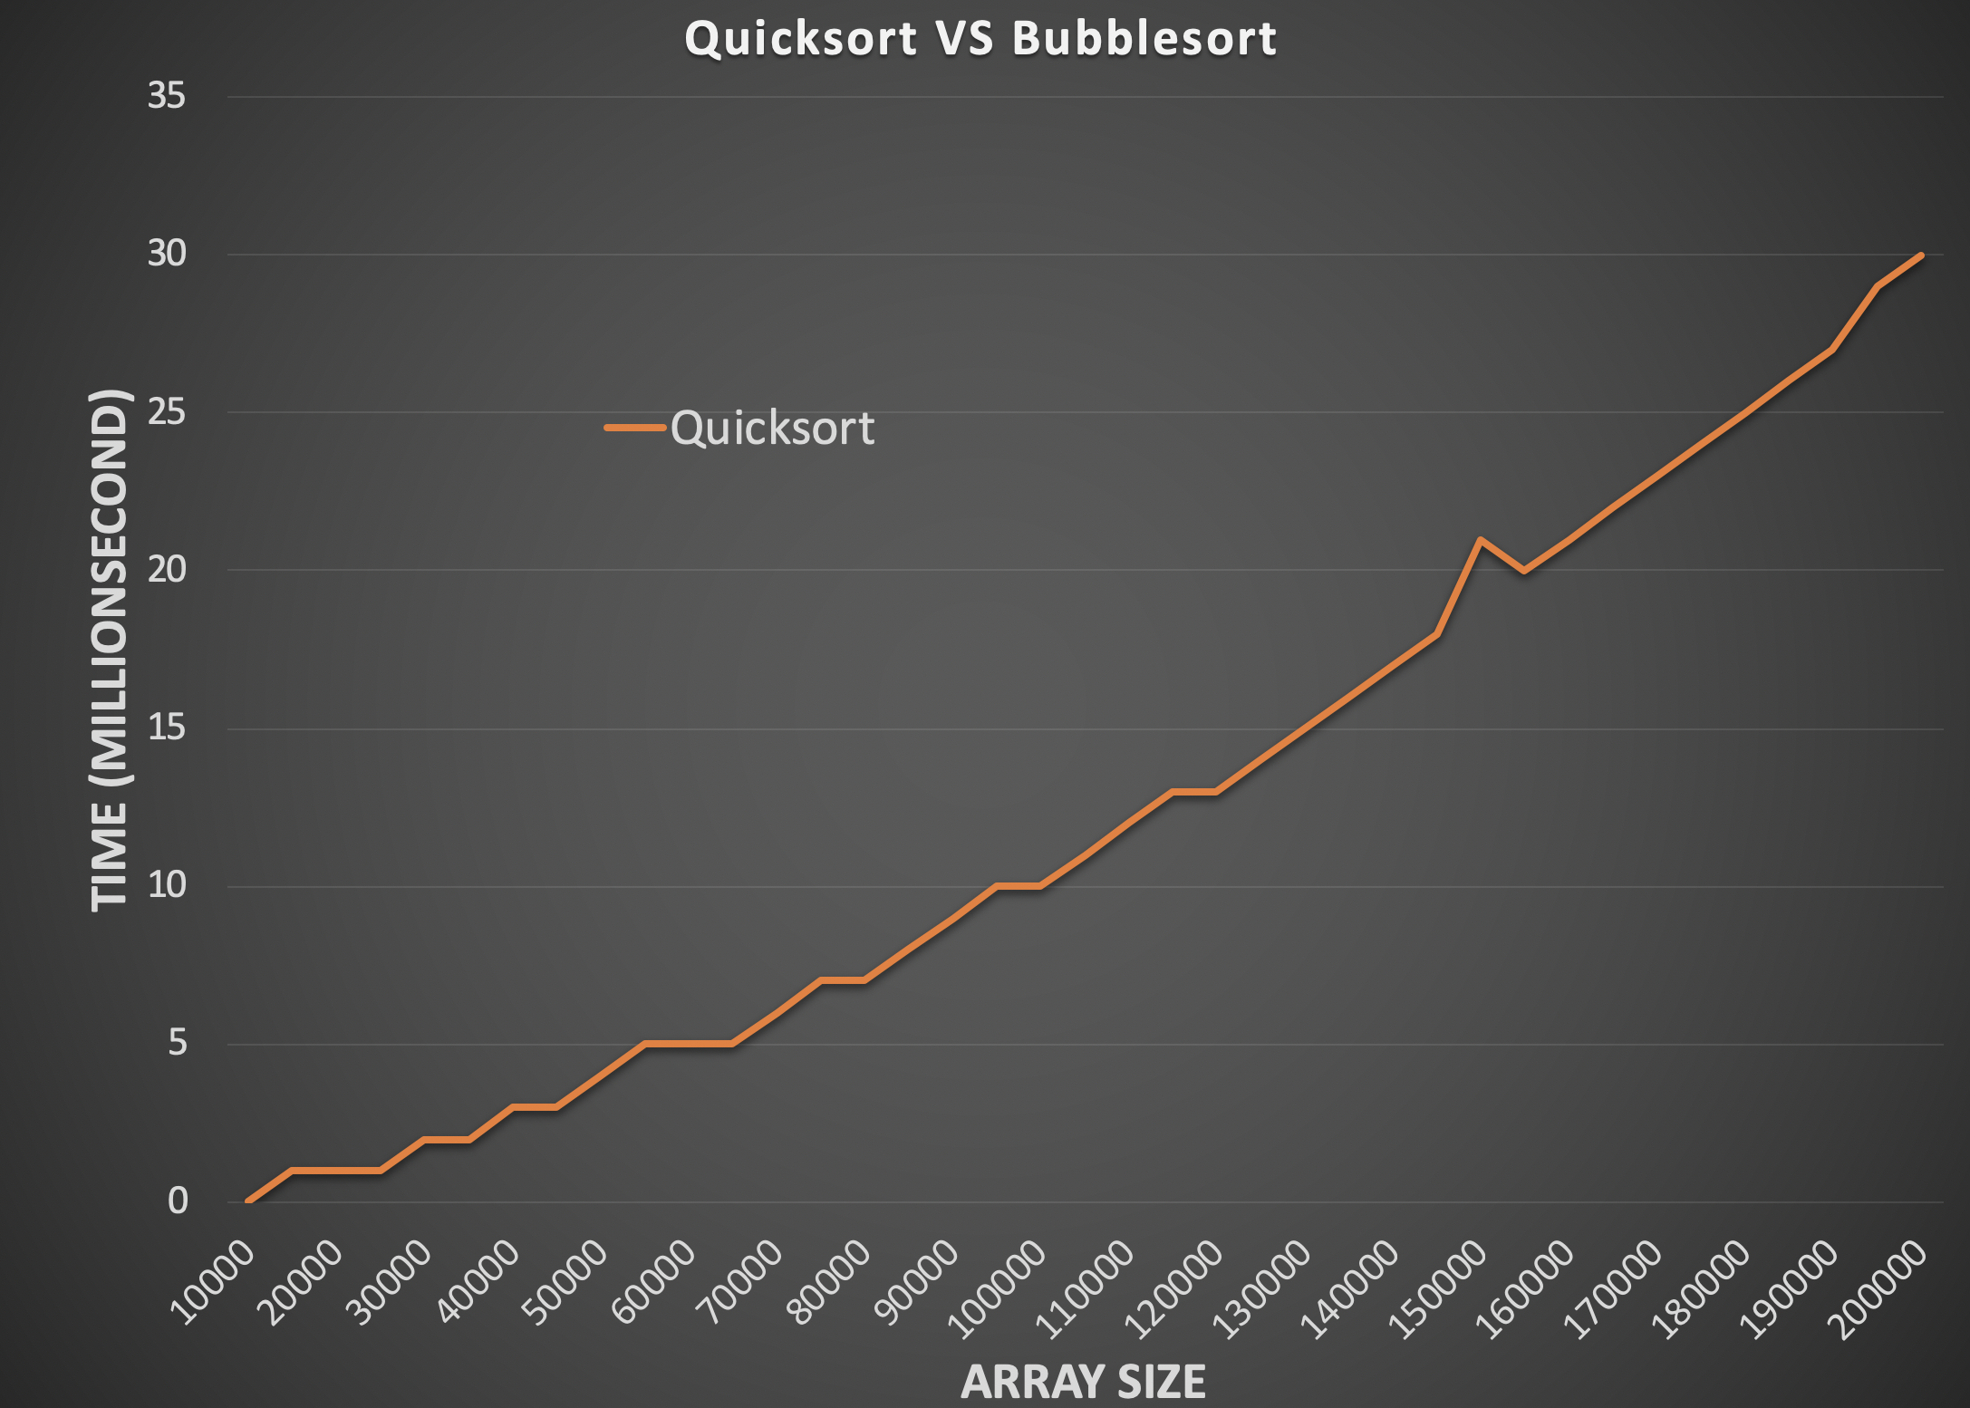
Bubble Sort vs Quick Sort

Slide 46
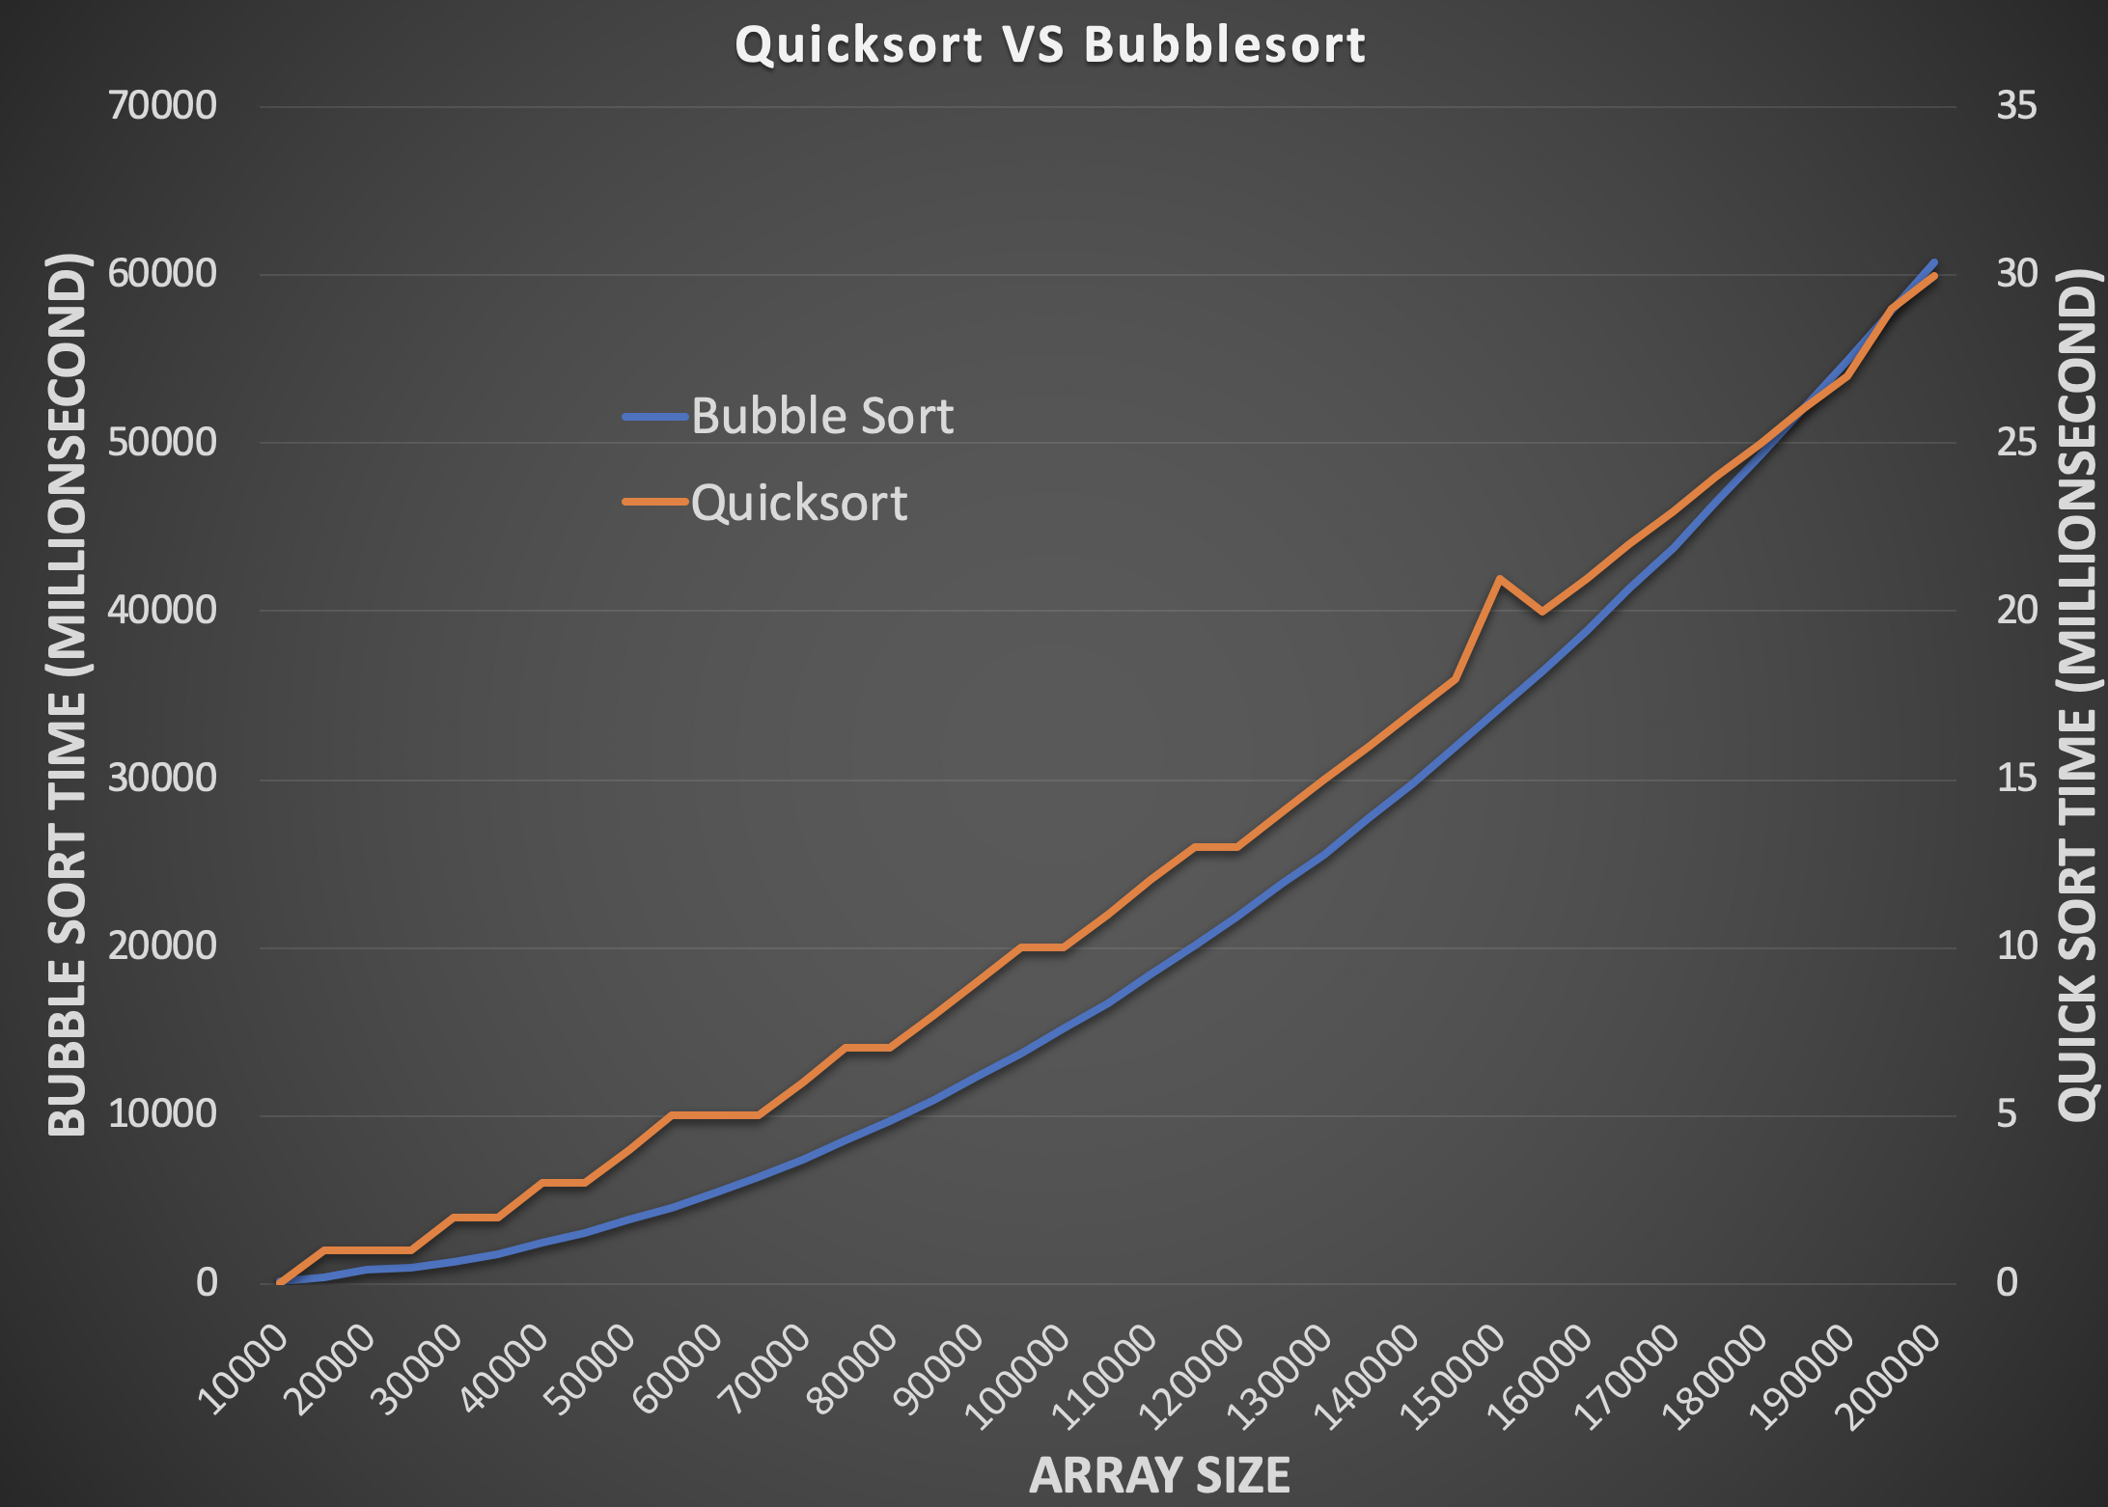
Bubble Sort vs Quick Sort

Slide 47
Bubble Sort vs Quick Sort
Which one is slower
Bubble sort
Which one is getting slower faster
Bubble sort
Quick sort is quick

Slide 48
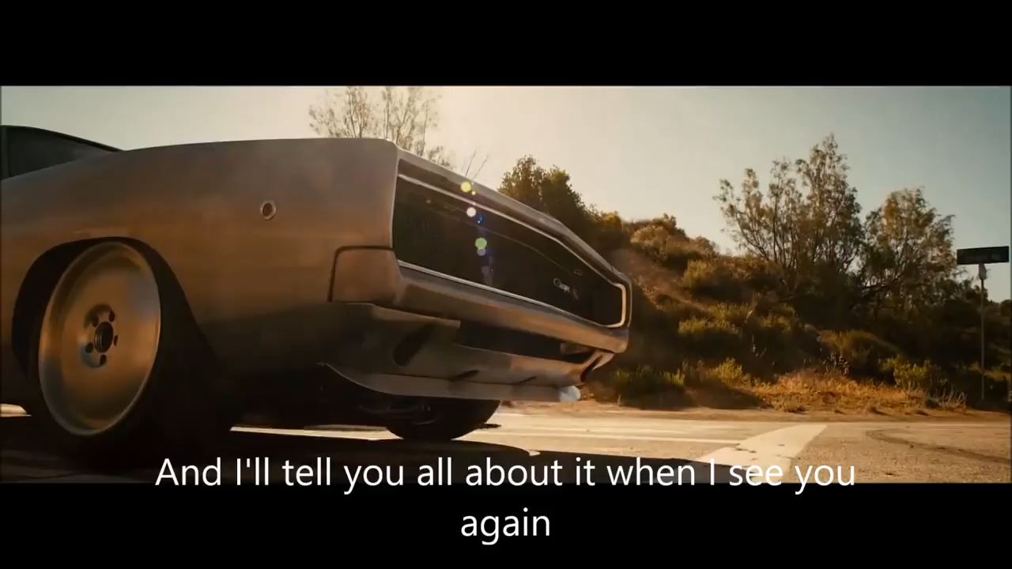
Clip rom “Fast and Furious 7”

Slide 49
Recursion
Problem A
sub-problem A₁
sub-problem A₂
sub-problem A₃
…
sub-problem A_{N}
Solution

Slide 50
Recursion
Problem A
sub-problem A₁
sub-problem A₂
sub-problem A₃
…
sub-problem A_{N}
Solution
1
1
1
1
1
2
3
4
1
3
6

Slide 51
Recursion
Problem B
sub-problem B₁
sub-problem B₂
sub-problem B₃
…
sub-problem B_{N}
Solution

Slide 52
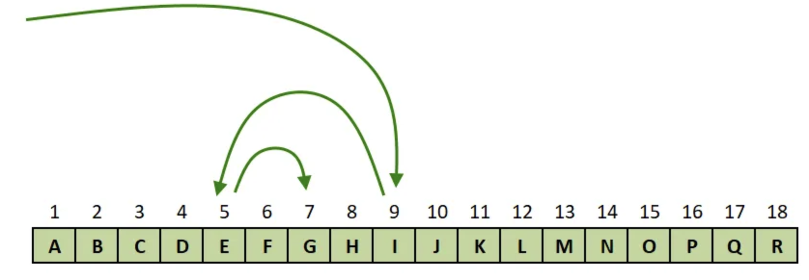
Recursion
Problem B
sub-problem B₁
sub-problem B₂
sub-problem B₃
…
sub-problem B_{N}
Solution
”decision”

Slide 53
Recursion Summary
Sum of an array
Subproblem: size – 1 of the array
Binary search
Subproblem: one half of the array
Quicksort
Subproblem: two halves of the array
Print single linked list reversely
Subproblem: size - 1 of the list
Chasing solution
Unique paths
parentheses
Trial and error

Slide 54
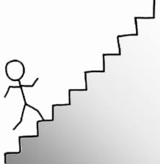
Recursion:
You are climbing a stair case. It takes n steps to reach to the top.
Each time you can either climb 1 or 2 steps.
In how many distinct ways can you climb to the top?

Slide 55
Recursion:
You are climbing a stair case. It takes n steps to reach to the top.
Each time you can either climb 1 or 2 steps.
In how many distinct ways can you climb to the top?

Slide 56
Example 4: Climbing Stairs
You are climbing a stair case. It takes n steps to reach to the top. Each time you can either climb 1 or 2 steps.
In how many distinct ways can you climb to the top?
1
n=1
0→1
F(1) = 1
0
0→1→2
N=2
F(2) = 2
0→2

Slide 57
Example 4: Climbing Stairs
You are climbing a stair case. It takes n steps to reach to the top. Each time you can either climb 1 or 2 steps.
In how many distinct ways can you climb to the top?
0→1→3
3
2
N=3
0→1→2→3
1
0
0→2→3

Slide 58
Example 4: Climbing Stairs
You are climbing a stair case. It takes n steps to reach to the top. Each time you can either climb 1 or 2 steps.
In how many distinct ways can you climb to the top?
0→1→3
F(1)
3
2
N=3
0→1→2→3
1
F(2)
0
0→2→3
F(3) = F(2)+F(1)
F(n) = F(n-1)+F(n-2)

